Slide 1
Different Approach in User roles
By MD Tariqule Hasan Khan

Slide 2
What is in this powerpoint?
Make user role
Customize login page?
Working with different Areas

Slide 3
Goal
Employees or User can view products from the site
Employees can add products to the site and edit and view them
Managers can add admin and remove admin, also add remove products

Slide 4
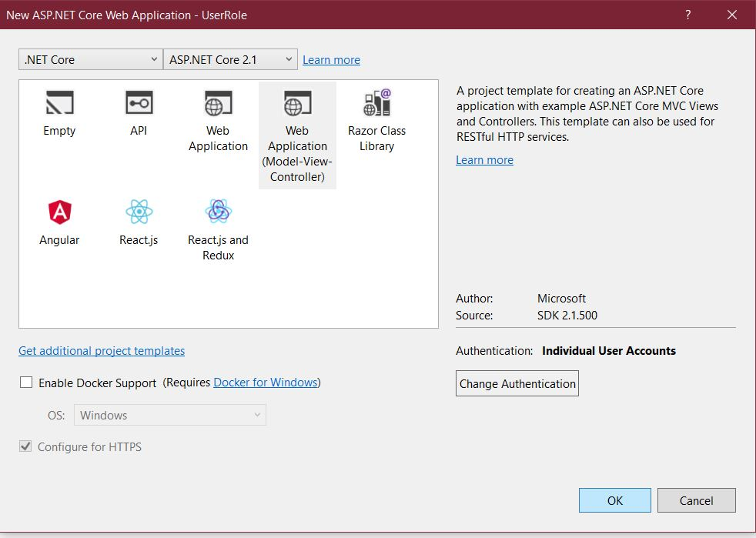
Create a project with Authentication

Slide 5
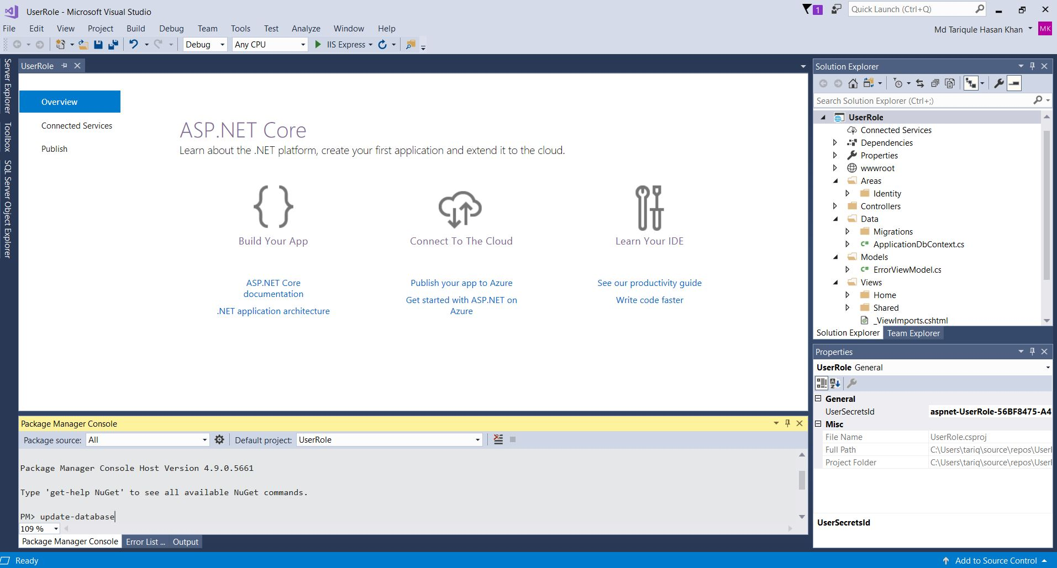
Update database
Whenever we choose to do authentication VS creates the database for us but this is not synced with out localDB.
Therefore update-database is needed.

Slide 6
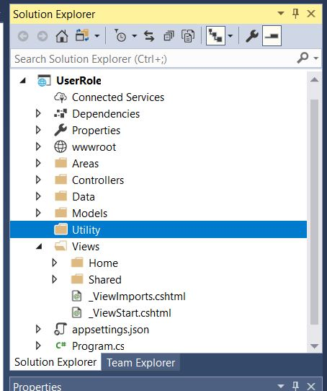
Create a folder called Utility

Slide 7
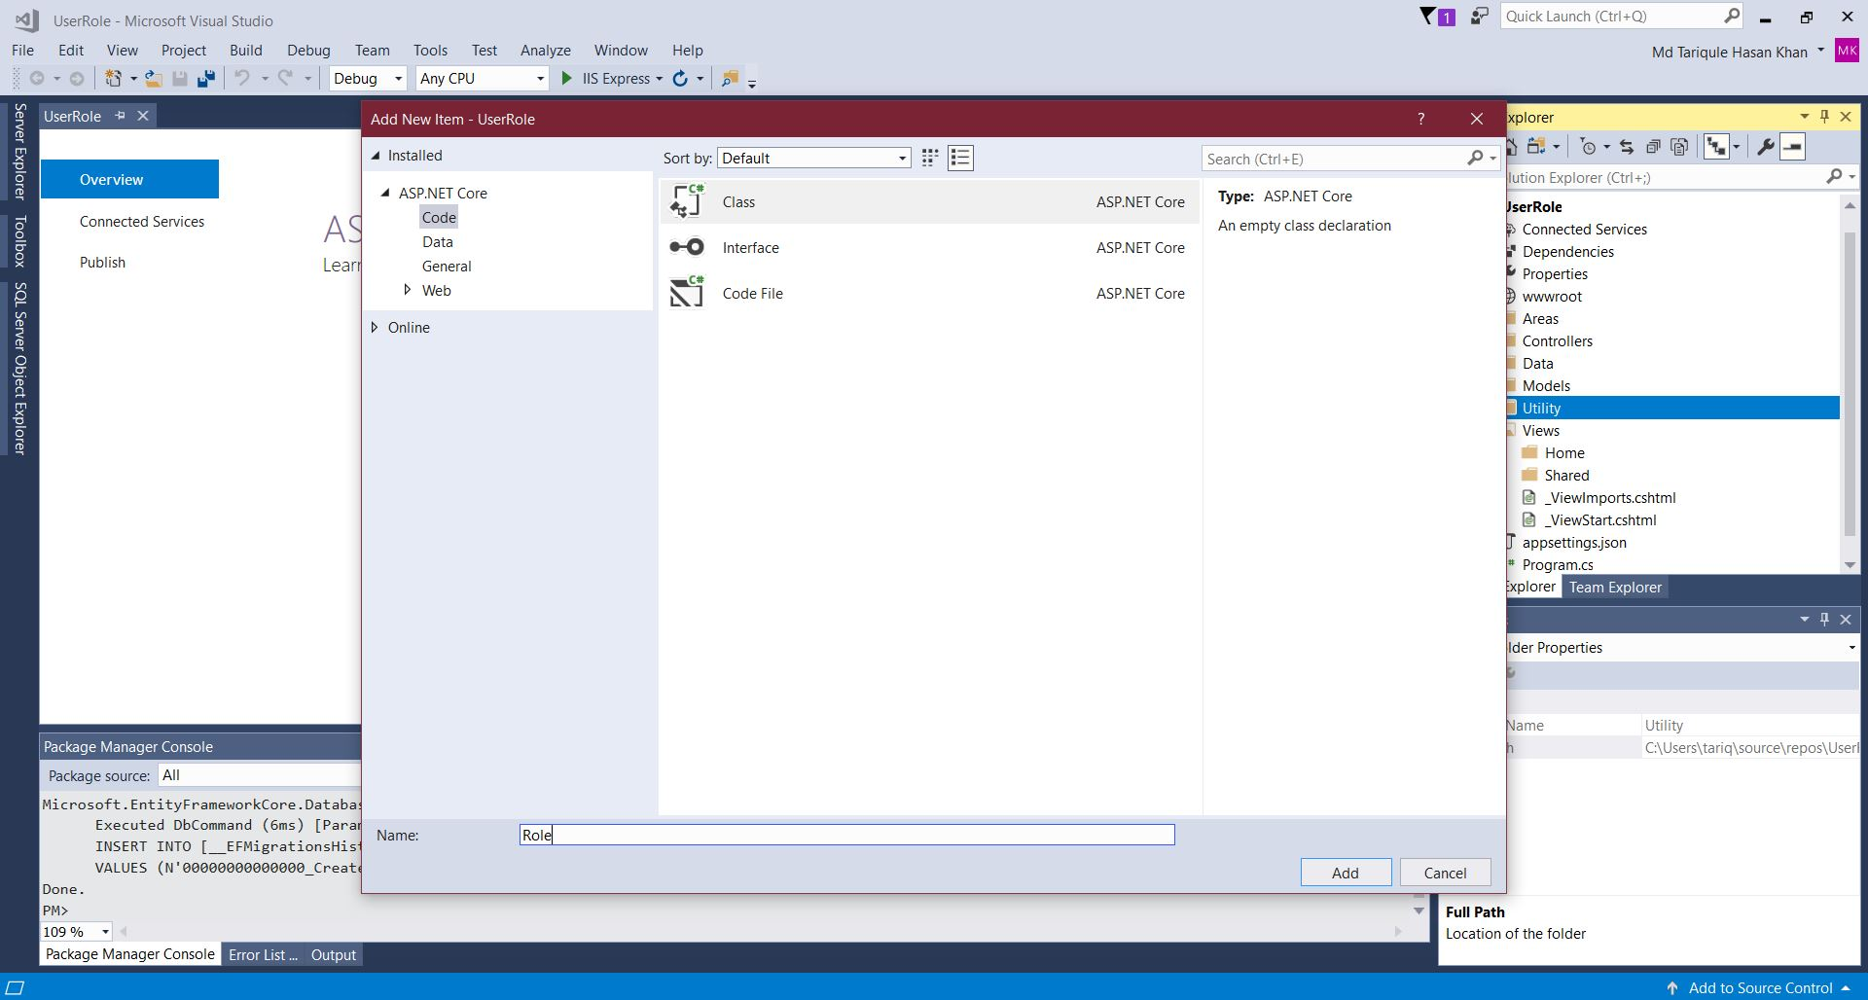
Add a class file called Roles

Slide 8
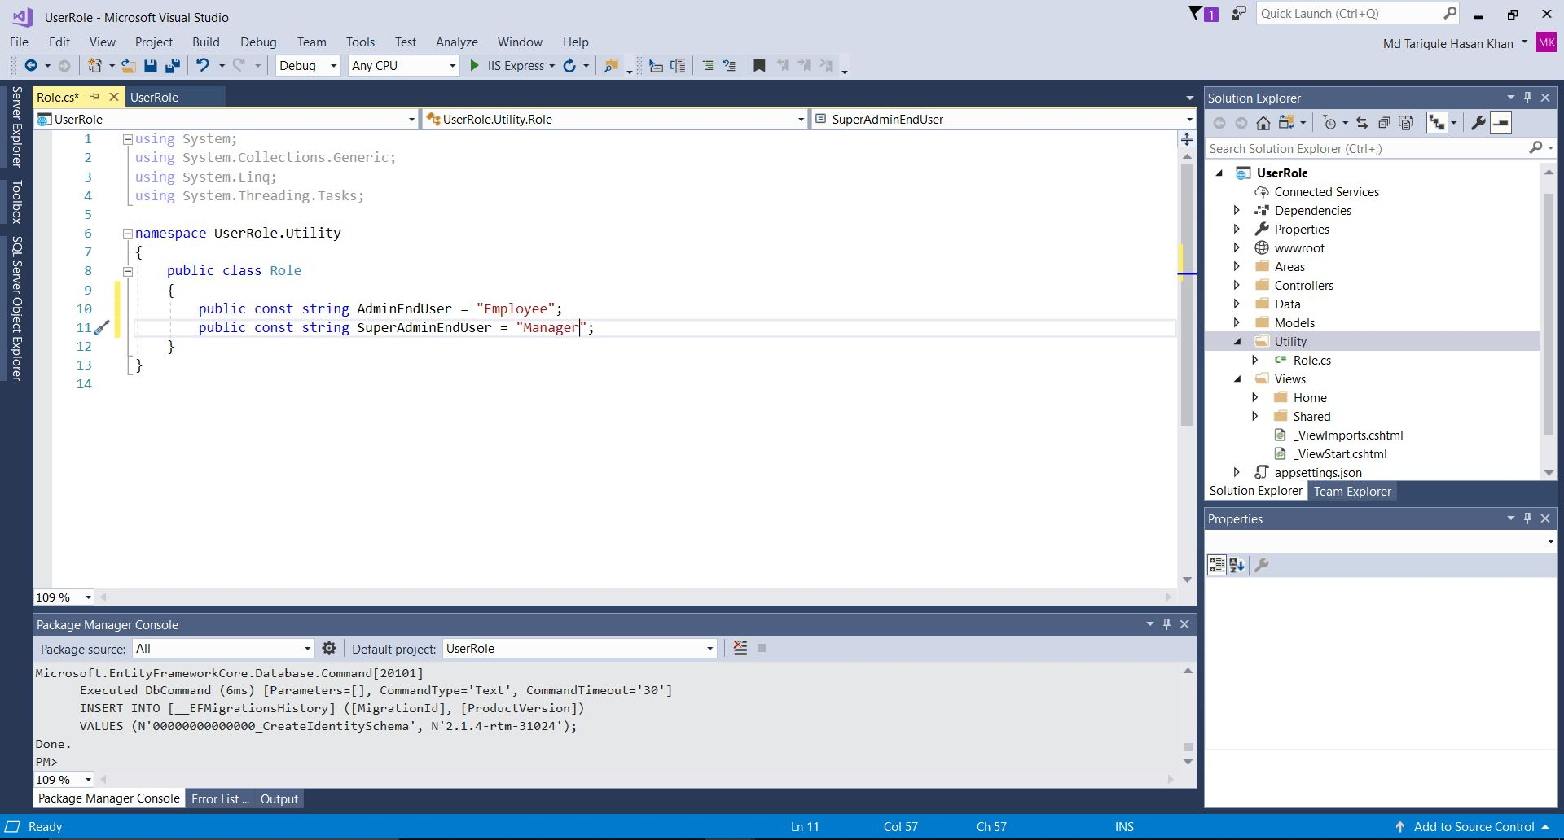
Now add some App users
Notes:
using System;
using System.Collections.Generic;
using System.Linq;
using System.Threading.Tasks;
namespace UserRole.Utility
{
public class Role
{
public const string AdminEndUser = "Employee";
public const string SuperAdminEndUser = "Manager";
}
}

Slide 9
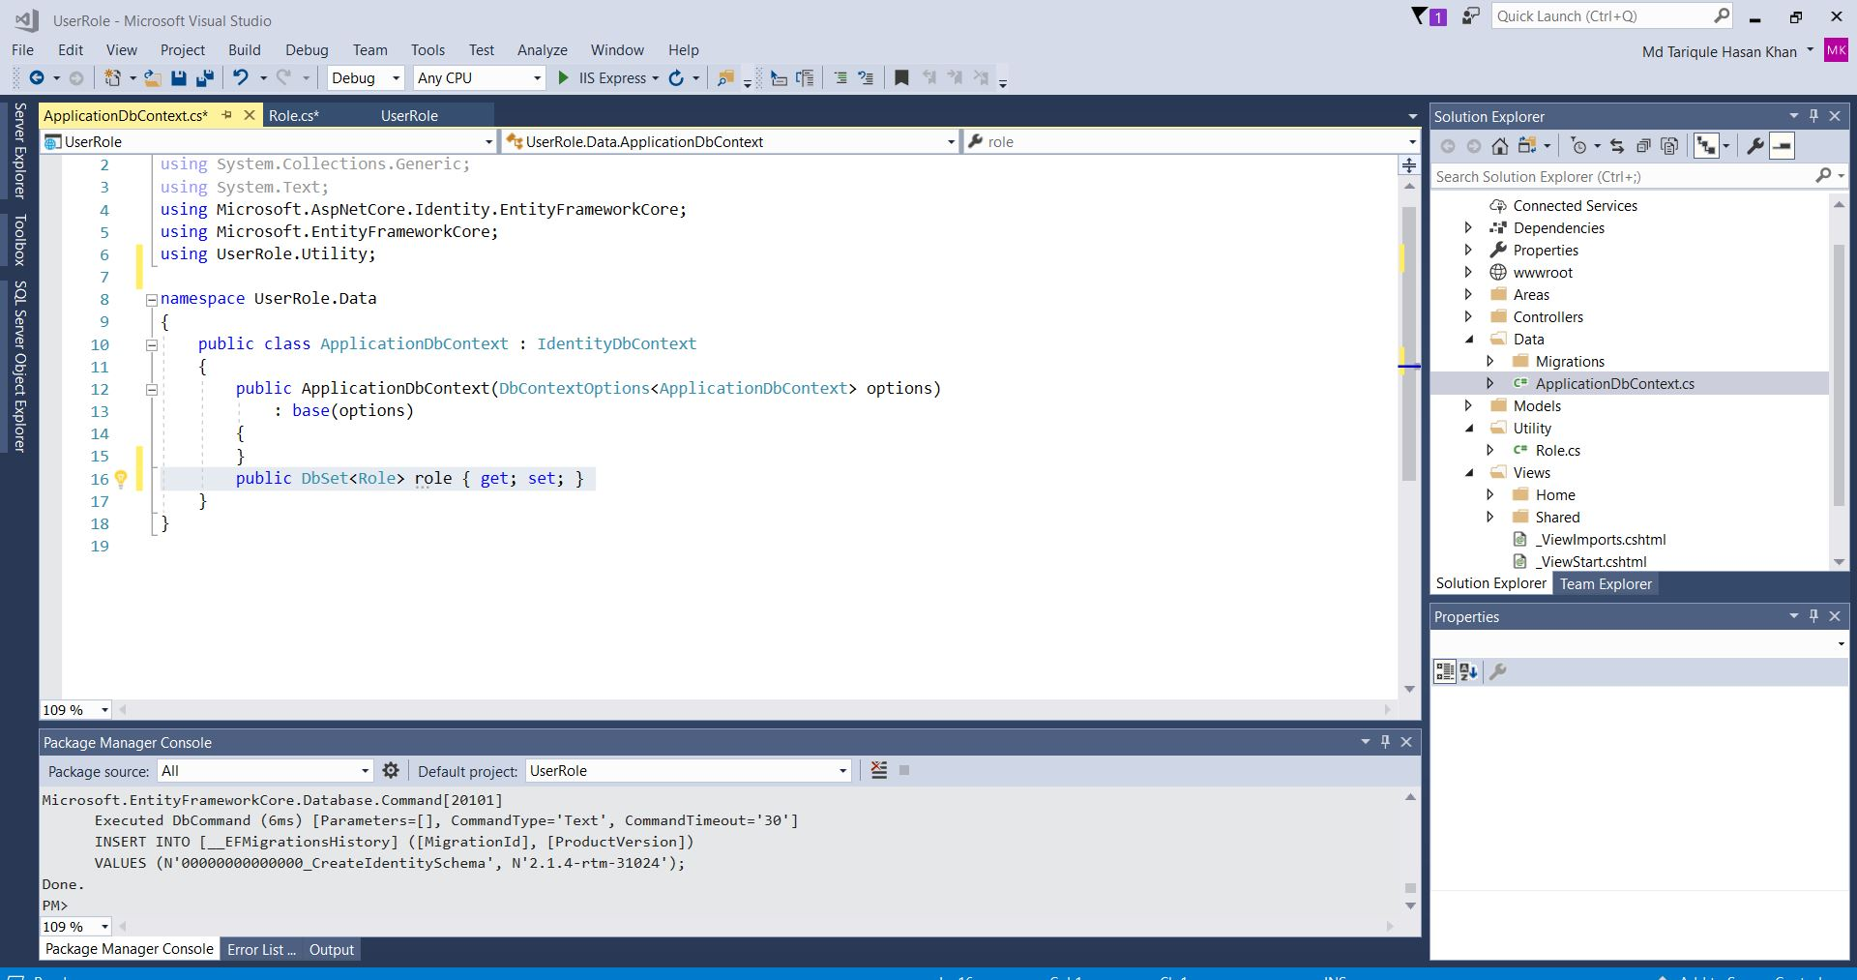
Add it to our ApplicationDbContext

Slide 10
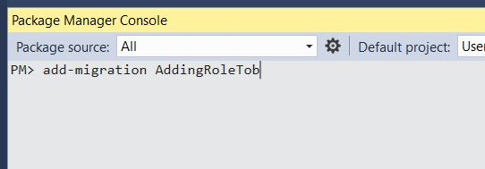
Lets do some migrations

Slide 11
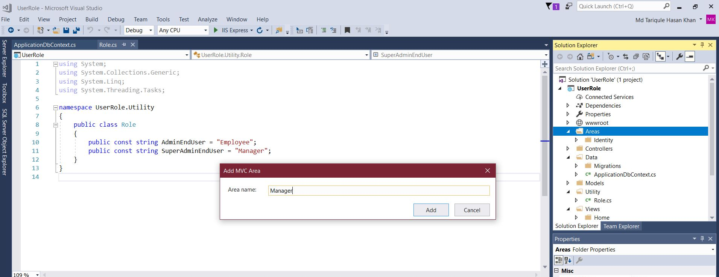
Lets add some Areas
On the Areas folder make new area called Manger.
Right click>add>Area

Slide 12
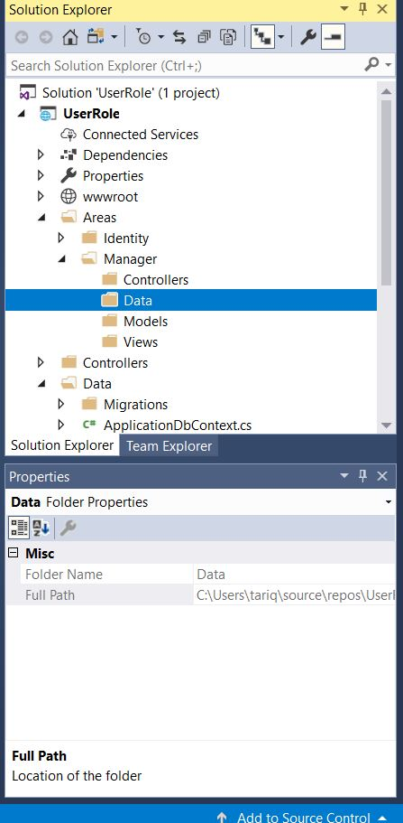
Lets removes things we don’t need
Remove Data and Models folder from Manger Folder.
As we will be using the model and that data that already exists in the solution

Slide 13
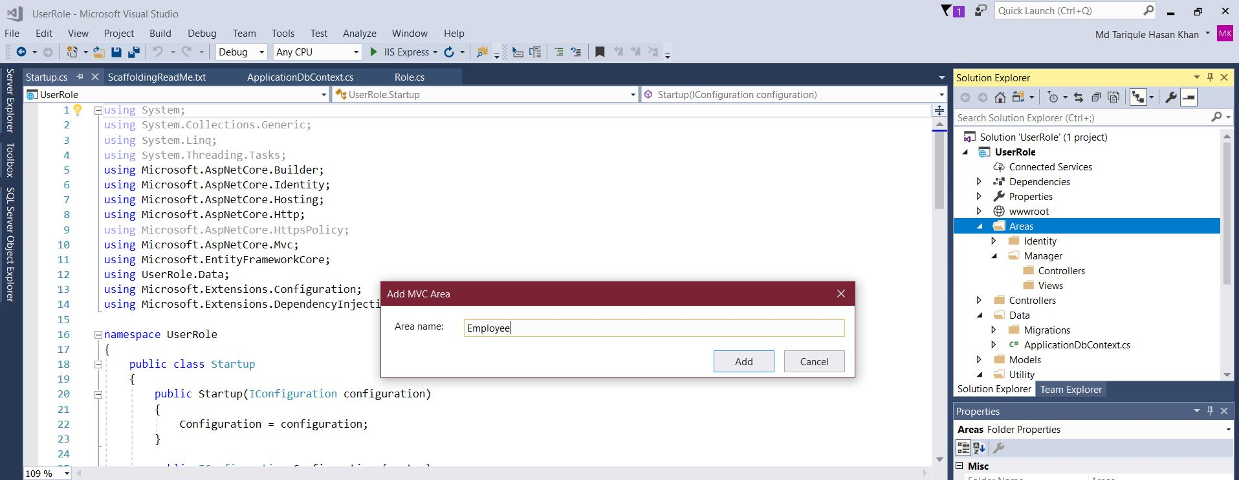
Create A Employee Area And do the same

Slide 14
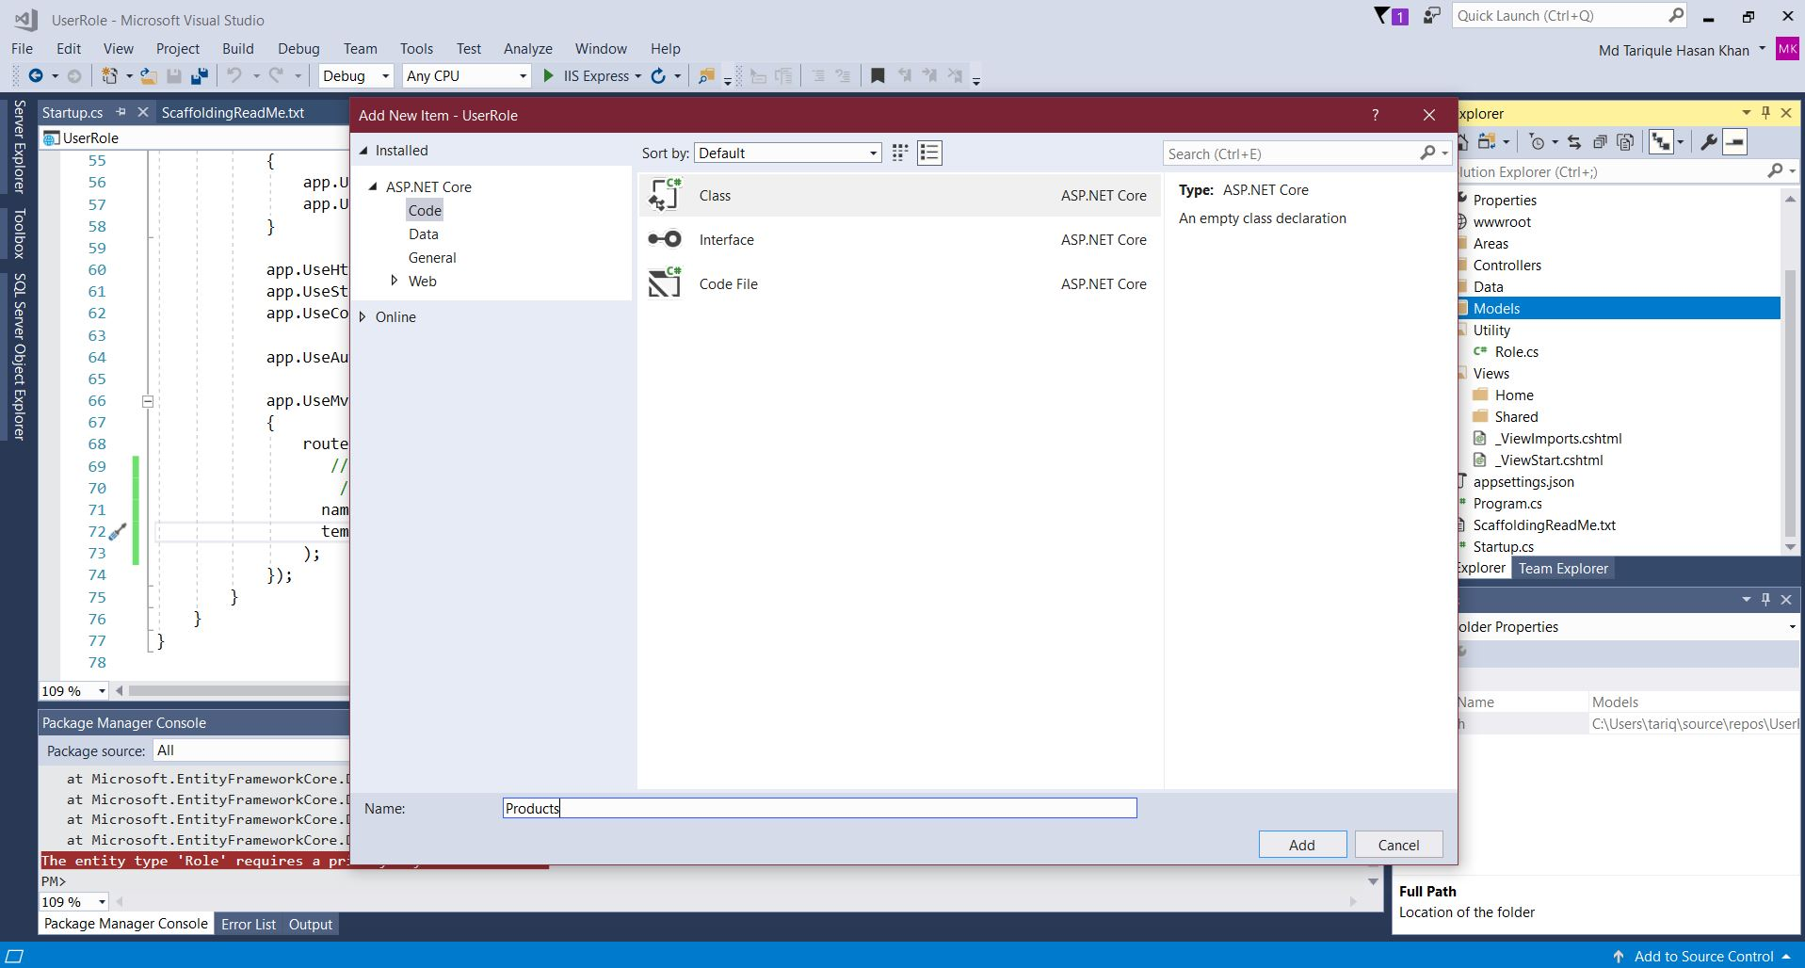
Now add a class in the model in solution
Name is Products

Slide 15
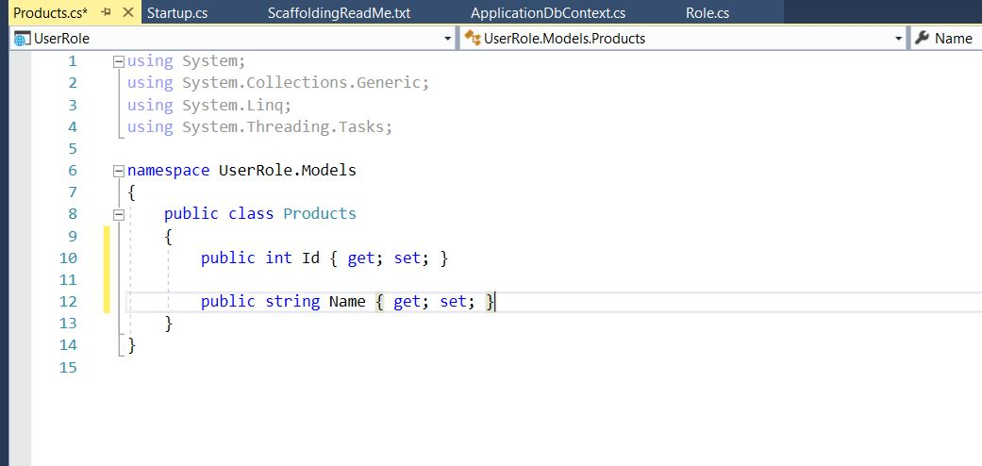
Lets add some properties
Notes:
using System;
using System.Collections.Generic;
using System.Linq;
using System.Threading.Tasks;
namespace UserRole.Models
{
public class Products
{
public int Id { get; set; }
public string Name { get; set; }
}
}

Slide 16
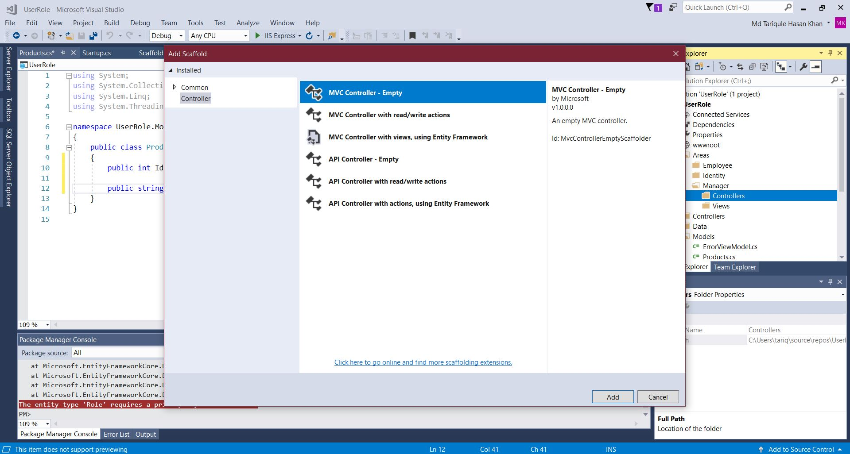
Lets make a Controller inside the Maneger
Create a empty controller because it easier that way

Slide 17
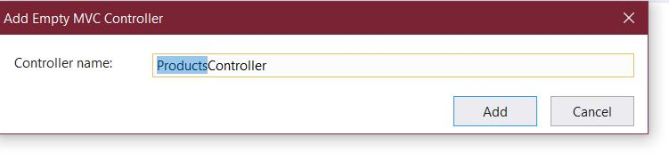
Name it Products

Slide 18
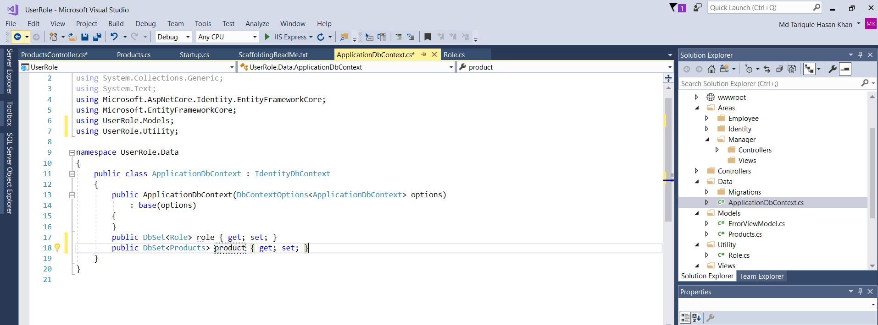
Lets Add The Product in the Database
Do the migrations:
Add-Migration AddingProducts
Update-database

Slide 19
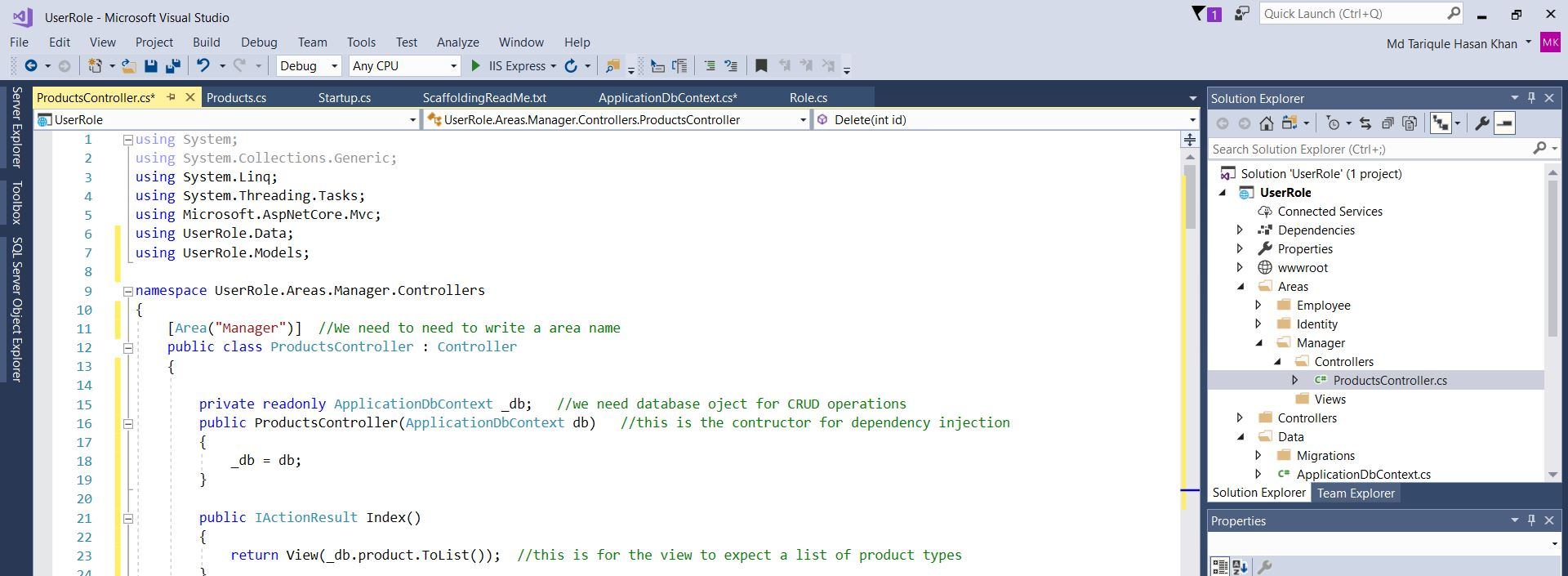
In the Products Controller Add the following
Notes:
using System;
using System.Collections.Generic;
using System.Linq;
using System.Threading.Tasks;
using Microsoft.AspNetCore.Authorization;
using Microsoft.AspNetCore.Mvc;
using UserRole.Data;
using UserRole.Models;
using UserRole.Utility;
namespace UserRole.Areas.Manager.Controllers
{
[Authorize(Roles = Role.AdminEndUser + "," + Role.SuperAdminEndUser)]
[Area("Manager")] //We need to need to write a area name
public class ProductsController : Controller
{
private readonly ApplicationDbContext _db; //we need database oject for CRUD operations
public ProductsController(ApplicationDbContext db) //this is the contructor for dependency injection
{
_db = db;
}
public IActionResult Index()
{
return View(_db.product.ToList()); //this is for the view to expect a list of product types
}
//get create action method
public IActionResult Create()
{
return View(); //this will direct you to create view
}
//post create action method
[HttpPost]
[ValidateAntiForgeryToken] //we write this to protect our site from cross-site scripting attacks and cross-site request forgery
public async Task<IActionResult> Create(Products product)
{
if (ModelState.IsValid) //we use this to check that all the required defined in model is valid
{
_db.Add(product); //if it is valid we will save it to database
await _db.SaveChangesAsync(); //we use await so our code will continue to run while it is been saved to db
return RedirectToAction(nameof(Index));
}
return View(product);
}
//now edit
//get create action method
public async Task<IActionResult> Edit(int? id)
{
if (id == null)
{
return NotFound();
}
var productType = await _db.product.FindAsync(id);
if (productType == null)
{
return NotFound();
}
return View(productType);
}
//post edit action method
[HttpPost]
[ValidateAntiForgeryToken]
public async Task<IActionResult> Edit(int id, Products product)
{
if (id != product.Id)
{
NotFound();
}
if (ModelState.IsValid) //we use this to check that all the required defined in model is valid
{
_db.Update(product); //if it is valid we will save it to database
await _db.SaveChangesAsync(); //we use await so our code will continue to run while it is been saved to db
return RedirectToAction(nameof(Index));
}
return View(product); //if it is not valid then it will pass through product type so it will display what was not valid
}
//now details
//get create action method
public async Task<IActionResult> Details(int? id)
{
if (id == null)
{
return NotFound();
}
var product = await _db.product.FindAsync(id);
if (product == null)
{
return NotFound();
}
return View(product);
}
//now delete
//get create action method
public async Task<IActionResult> Delete(int? id)
{
if (id == null)
{
return NotFound();
}
var product = await _db.product.FindAsync(id);
if (product == null)
{
return NotFound();
}
return View(product);
}
//post delete action method
[HttpPost]
[ValidateAntiForgeryToken]
public async Task<IActionResult> Delete(int id) //if you wanna change the name of delete here then on the [httpost] you need to add [HttpPost, ActionName"Delete"]
{
var product = await _db.product.FindAsync(id);
_db.product.Remove(product);
await _db.SaveChangesAsync();
return RedirectToAction(nameof(Index));
}
}
}

Slide 20
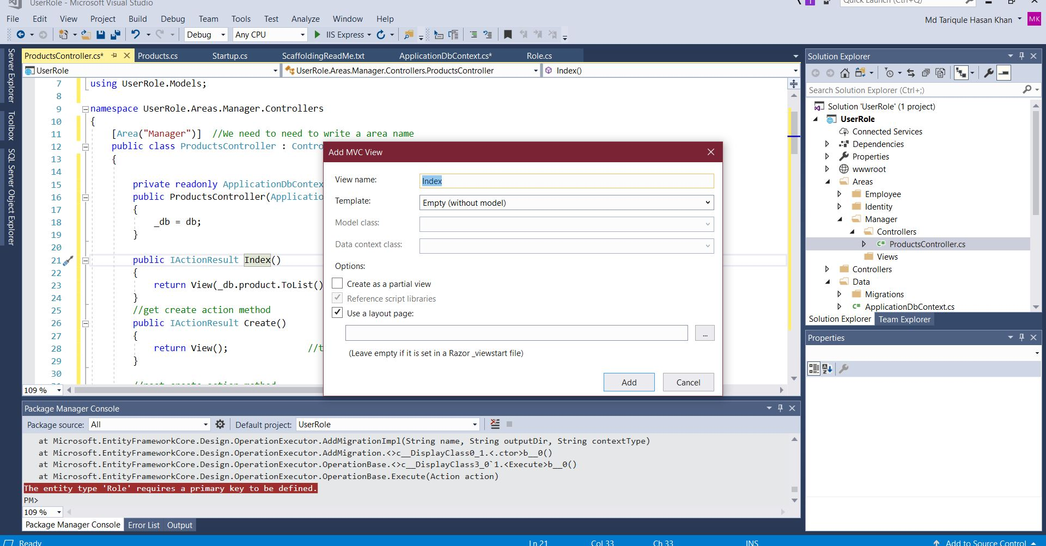
Lets Make some View for Products
Right Click on Index and click on Add View. Then Create an empty View

Slide 21
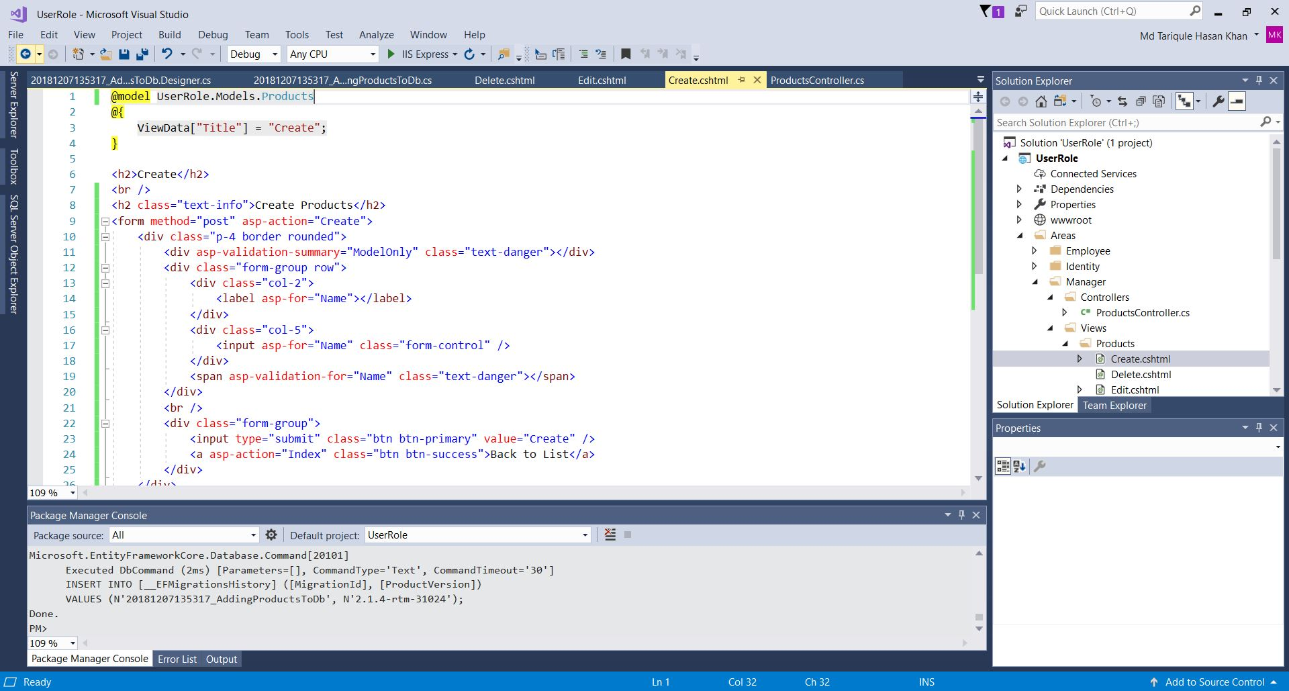
Add all the CRUD in the view
Codes Below
For Create
Notes:
@model UserRole.Models.Products
@{
ViewData["Title"] = "Create";
}
<h2>Create</h2>
<br />
<h2 class="text-info">Create Products</h2>
<form method="post" asp-action="Create">
<div class="p-4 border rounded">
<div asp-validation-summary="ModelOnly" class="text-danger"></div>
<div class="form-group row">
<div class="col-2">
<label asp-for="Name"></label>
</div>
<div class="col-5">
<input asp-for="Name" class="form-control" />
</div>
<span asp-validation-for="Name" class="text-danger"></span>
</div>
<br />
<div class="form-group">
<input type="submit" class="btn btn-primary" value="Create" />
<a asp-action="Index" class="btn btn-success">Back to List</a>
</div>
</div>
</form>
@section Scripts{
@{ await Html.RenderPartialAsync("_ValidationScriptsPartial");}
}

Slide 22
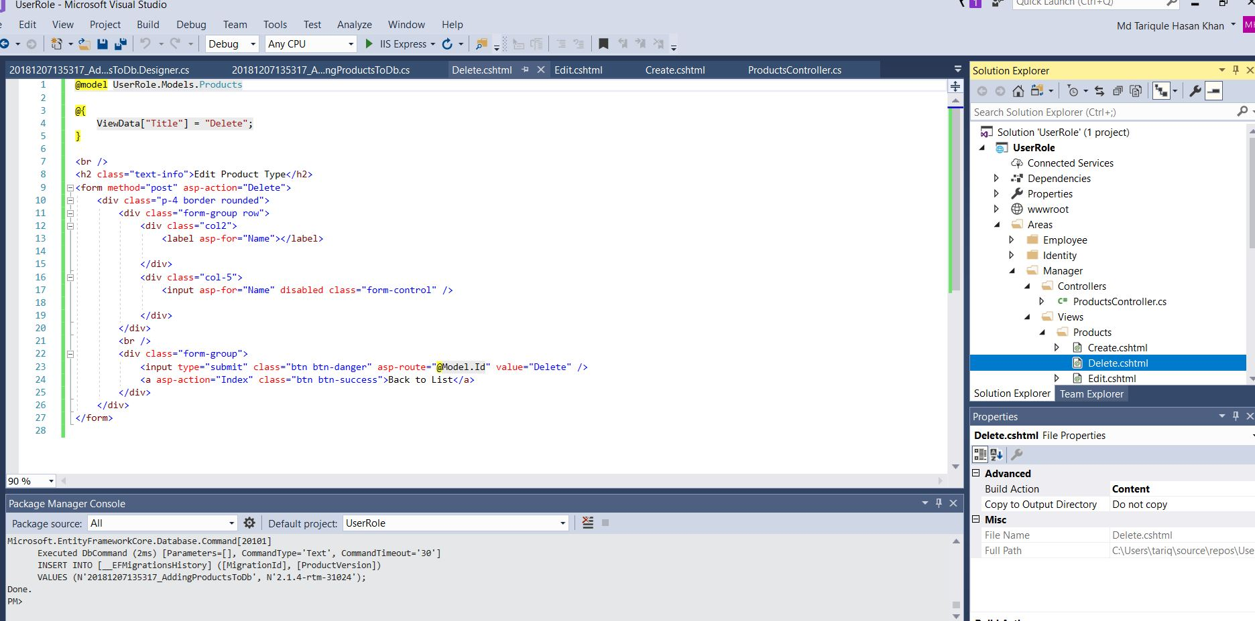
Delete View For Products
Notes:
@model UserRole.Models.Products
@{
ViewData["Title"] = "Delete";
}
<br />
<h2 class="text-info">Edit Product Type</h2>
<form method="post" asp-action="Delete">
<div class="p-4 border rounded">
<div class="form-group row">
<div class="col2">
<label asp-for="Name"></label>
</div>
<div class="col-5">
<input asp-for="Name" disabled class="form-control" />
</div>
</div>
<br />
<div class="form-group">
<input type="submit" class="btn btn-danger" asp-route="@Model.Id" value="Delete" />
<a asp-action="Index" class="btn btn-success">Back to List</a>
</div>
</div>
</form>

Slide 23
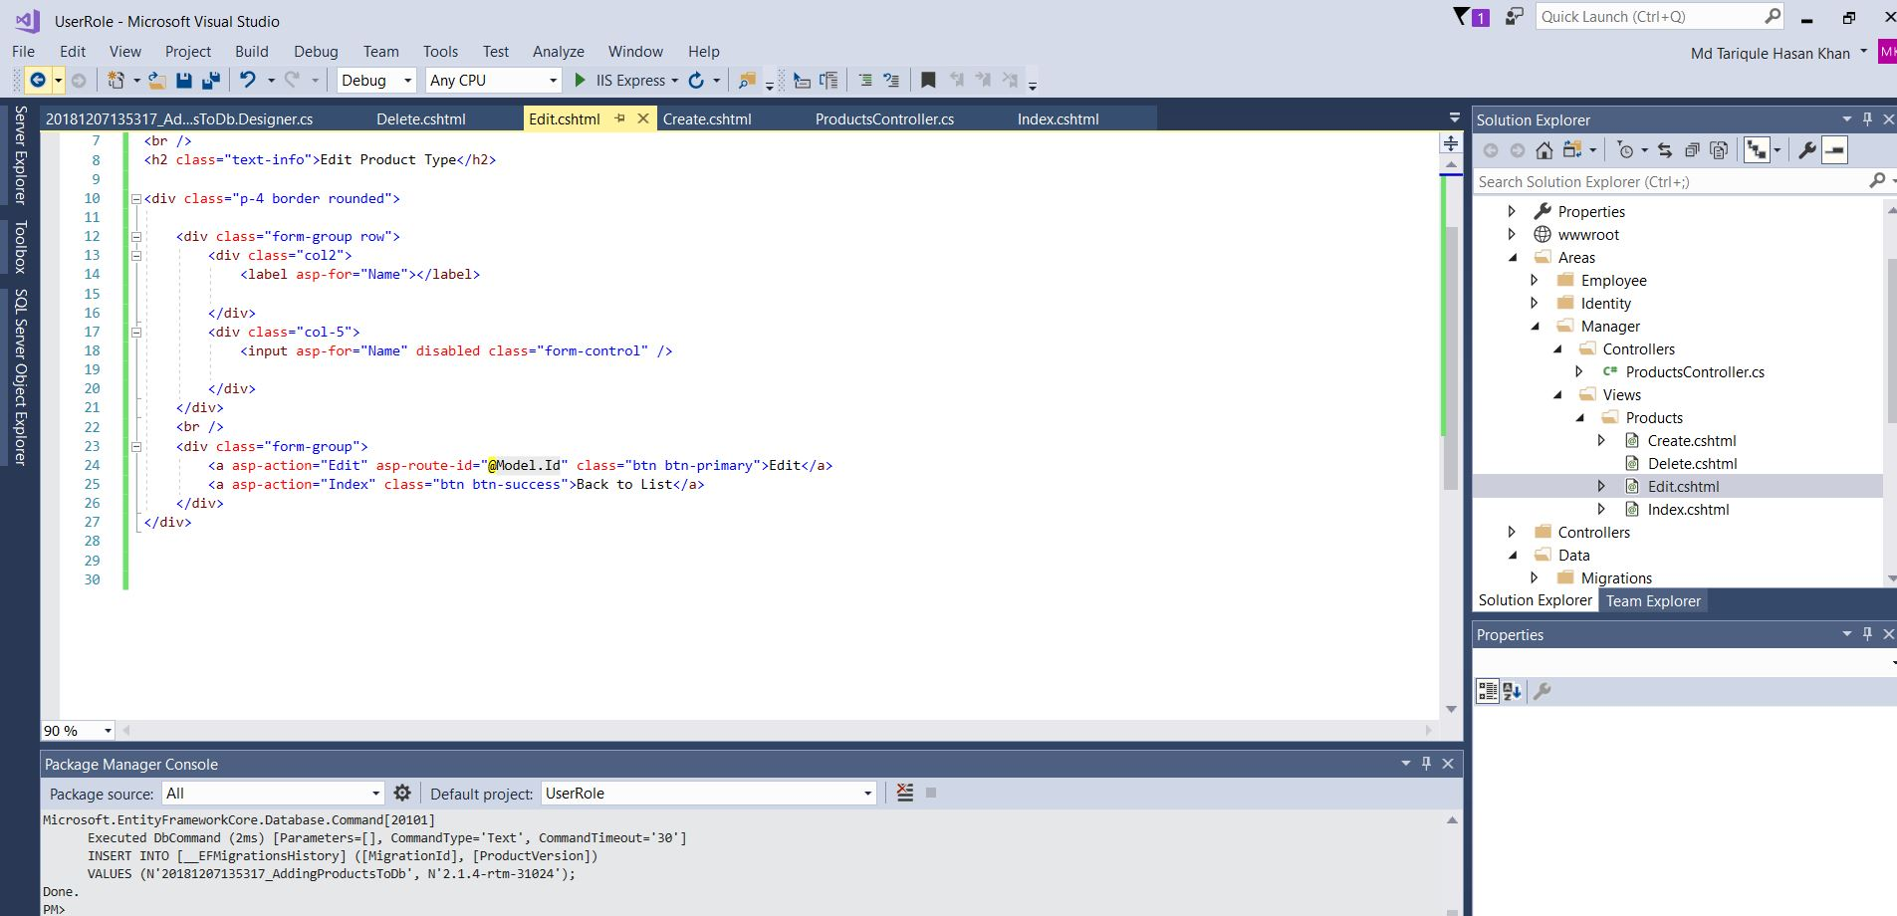
Edit View For Products
Notes:
@model UserRole.Models.Products
@{
ViewData["Title"] = "Details";
}
<br />
<h2 class="text-info">Edit Product Type</h2>
<div class="p-4 border rounded">
<div class="form-group row">
<div class="col2">
<label asp-for="Name"></label>
</div>
<div class="col-5">
<input asp-for="Name" disabled class="form-control" />
</div>
</div>
<br />
<div class="form-group">
<a asp-action="Edit" asp-route-id="@Model.Id" class="btn btn-primary">Edit</a>
<a asp-action="Index" class="btn btn-success">Back to List</a>
</div>
</div>

Slide 24
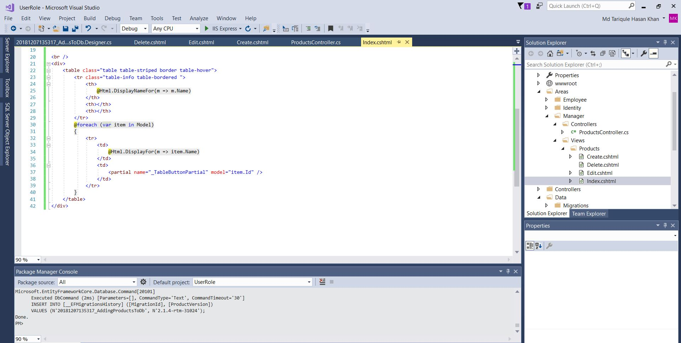
Index View for Products
Notes:
@model IEnumerable<UserRole.Models.Products>
@{
ViewData["Title"] = "Index";
}
<br /><br />
<div class="row">
<div class="col-6">
<h2 class="text-info">
Product Type List
</h2>
</div>
<div class="col-6 text-right">
<a asp-action="Create" class="btn btn-info"><i class="btn btn-info"></i>&nbsp; New Product Type</a>
</div>
</div>
<br />
<div>
<table class="table table-striped border table-hover">
<tr class="table-info table-bordered ">
<th>
@Html.DisplayNameFor(m => m.Name)
</th>
<th></th>
<th></th>
</tr>
@foreach (var item in Model)
{
<tr>
<td>
@Html.DisplayFor(m => item.Name)
</td>
<td>
<partial name="_TableButtonPartial" model="item.Id" />
</td>
</tr>
}
</table>
</div>

Slide 25
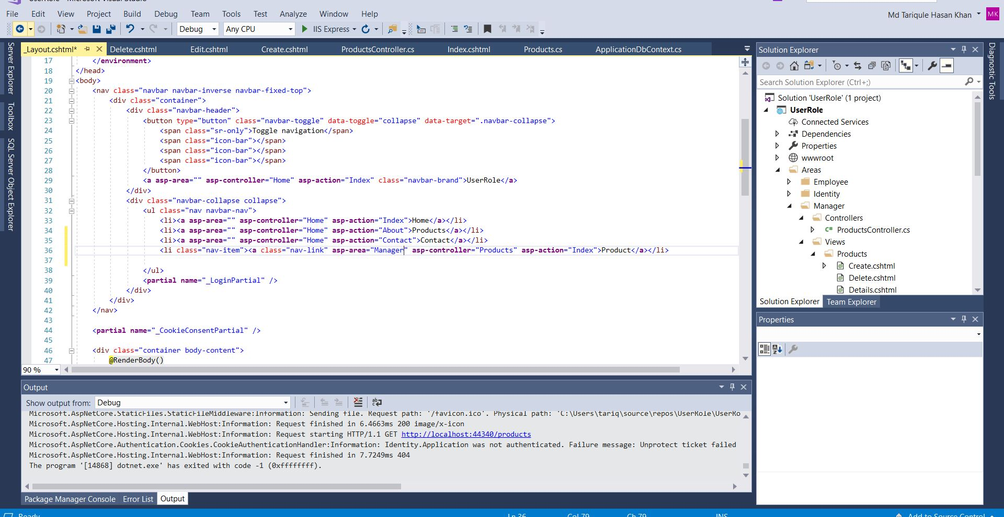
Lets add the product in the _Layout view

Slide 26
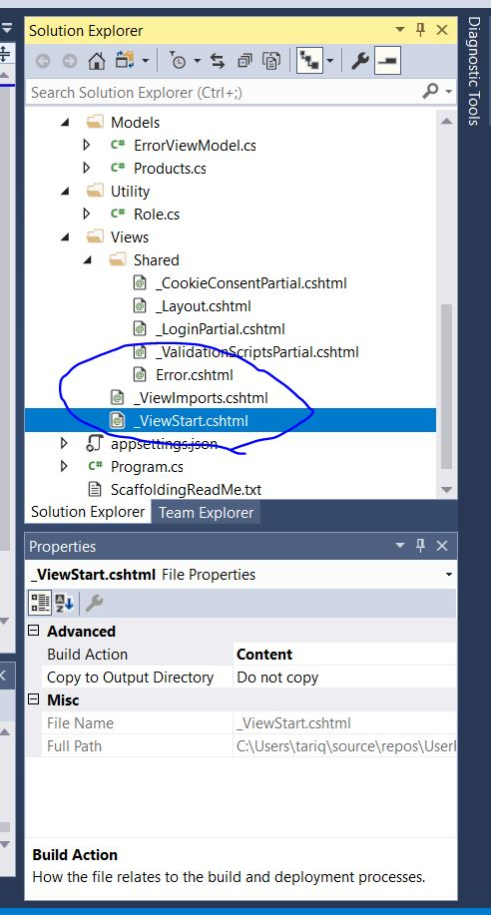
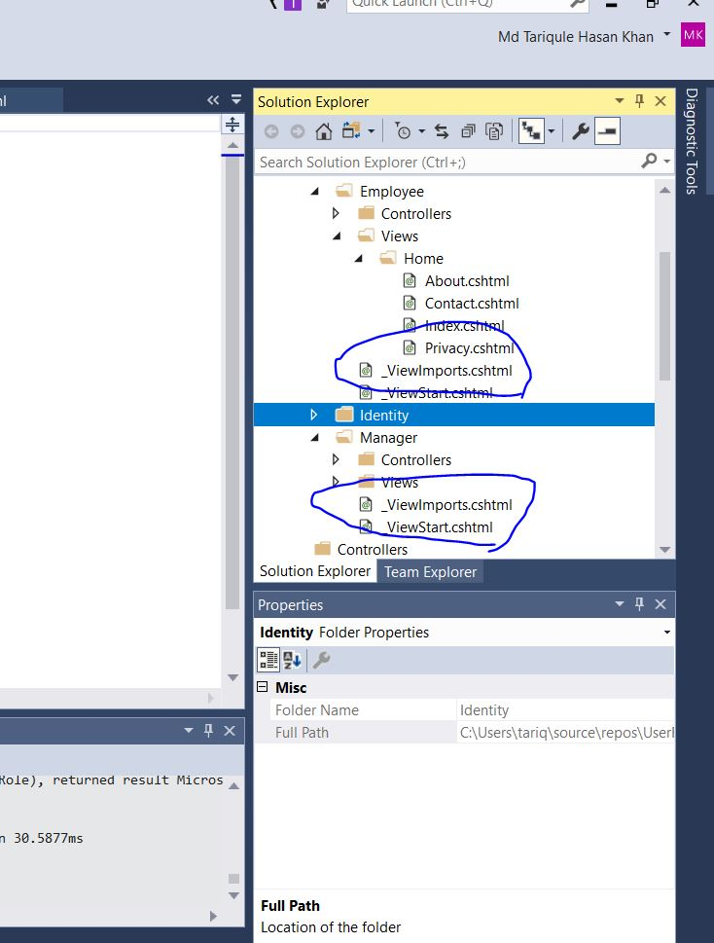
This are important things to copy from the Views and paste it in the Manager Folder And Employee Folder

Slide 27
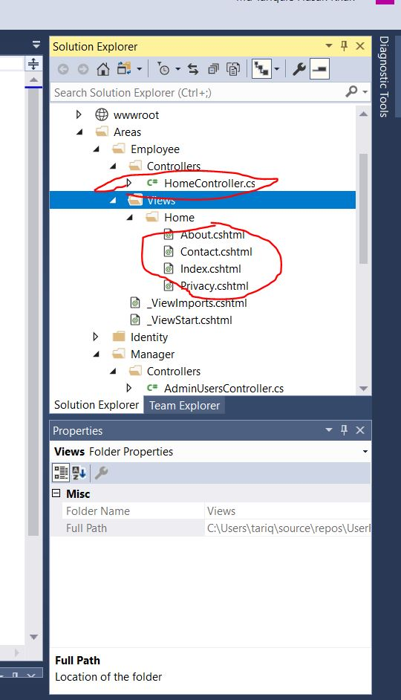
Move the HomeController and views
Move the Home Controller And views to Employee Folder. This makes our task faster.

Slide 28
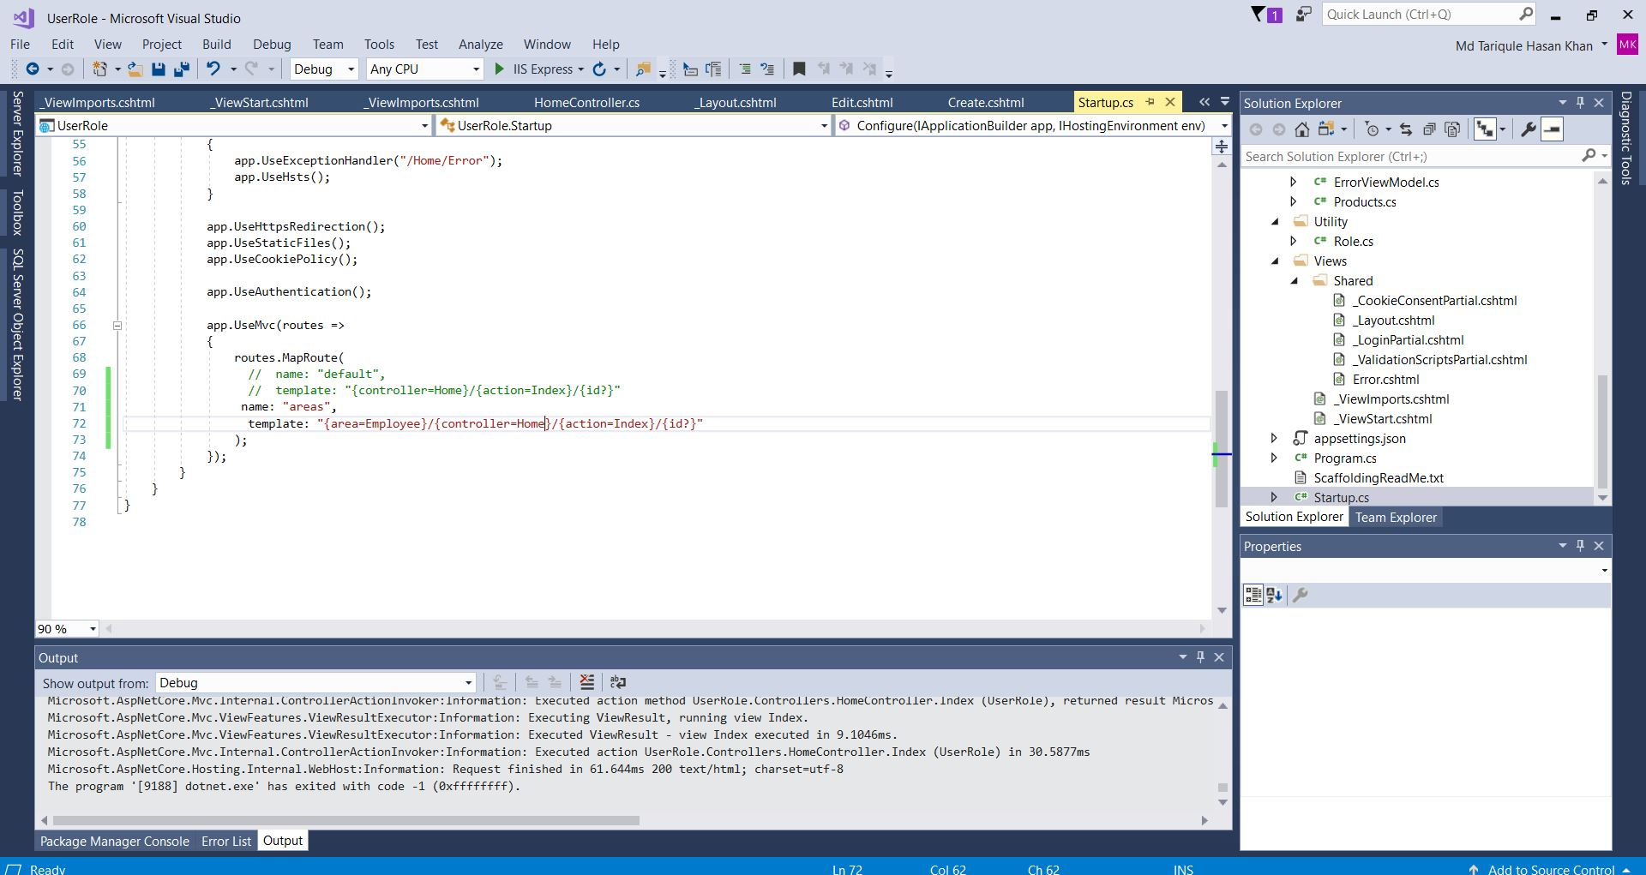
Now Edit the StartUp class as follows
Notes:
using System;
using System.Collections.Generic;
using System.Linq;
using System.Threading.Tasks;
using Microsoft.AspNetCore.Builder;
using Microsoft.AspNetCore.Identity;
using Microsoft.AspNetCore.Hosting;
using Microsoft.AspNetCore.Http;
using Microsoft.AspNetCore.HttpsPolicy;
using Microsoft.AspNetCore.Mvc;
using Microsoft.EntityFrameworkCore;
using UserRole.Data;
using Microsoft.Extensions.Configuration;
using Microsoft.Extensions.DependencyInjection;
namespace UserRole
{
public class Startup
{
public Startup(IConfiguration configuration)
{
Configuration = configuration;
}
public IConfiguration Configuration { get; }
// This method gets called by the runtime. Use this method to add services to the container.
public void ConfigureServices(IServiceCollection services)
{
services.Configure<CookiePolicyOptions>(options =>
{
// This lambda determines whether user consent for non-essential cookies is needed for a given request.
options.CheckConsentNeeded = context => true;
options.MinimumSameSitePolicy = SameSiteMode.None;
});
services.AddDbContext<ApplicationDbContext>(options =>
options.UseSqlServer(
Configuration.GetConnectionString("DefaultConnection")));
// services.AddDefaultIdentity<IdentityUser>()
// .AddEntityFrameworkStores<ApplicationDbContext>();
services.AddIdentity<IdentityUser, IdentityRole>() //adding identing role
.AddEntityFrameworkStores<ApplicationDbContext>()
.AddDefaultUI()
.AddDefaultTokenProviders();
services.AddMvc().SetCompatibilityVersion(CompatibilityVersion.Version_2_1);
}
// This method gets called by the runtime. Use this method to configure the HTTP request pipeline.
public void Configure(IApplicationBuilder app, IHostingEnvironment env)
{
if (env.IsDevelopment())
{
app.UseDeveloperExceptionPage();
app.UseDatabaseErrorPage();
}
else
{
app.UseExceptionHandler("/Home/Error");
app.UseHsts();
}
app.UseHttpsRedirection();
app.UseStaticFiles();
app.UseCookiePolicy();
app.UseAuthentication();
app.UseMvc(routes =>
{
routes.MapRoute(
// name: "default",
// template: "{controller=Home}/{action=Index}/{id?}"
name: "areas",
template: "{area=Employee}/{controller=Home}/{action=Index}/{id?}"
);
});
}
}
}

Slide 29
Now Lets Run The Project!

Slide 30
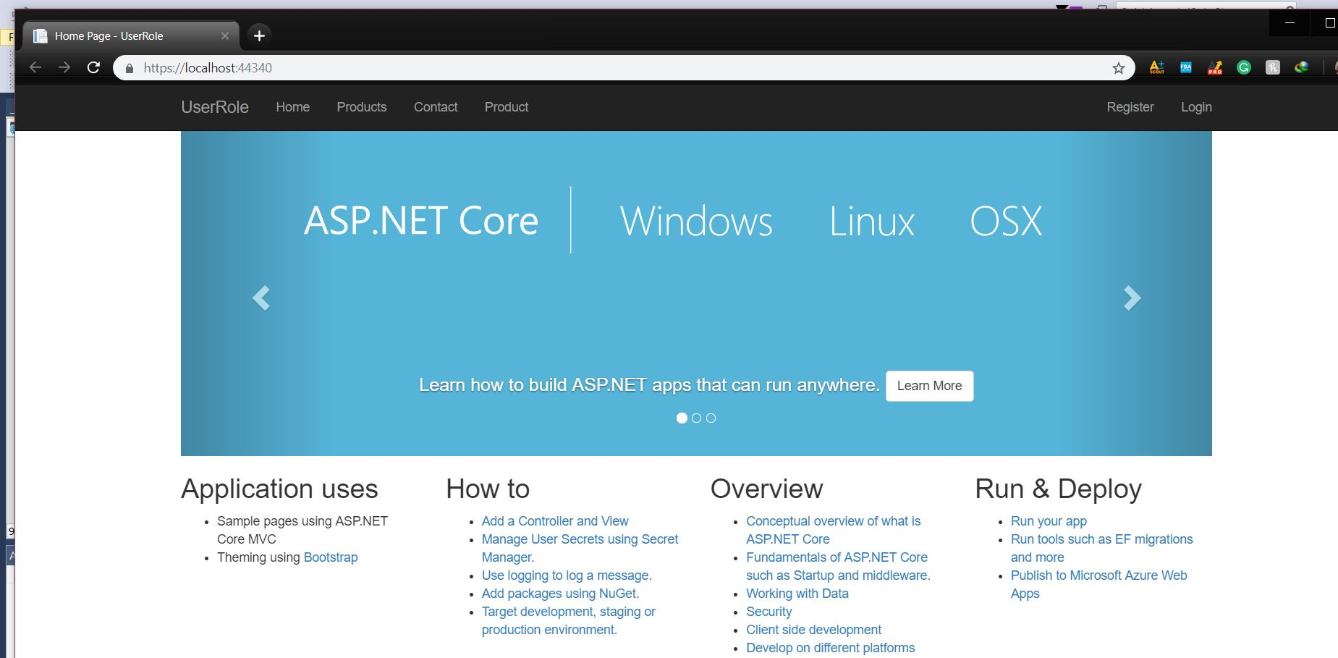

Slide 31
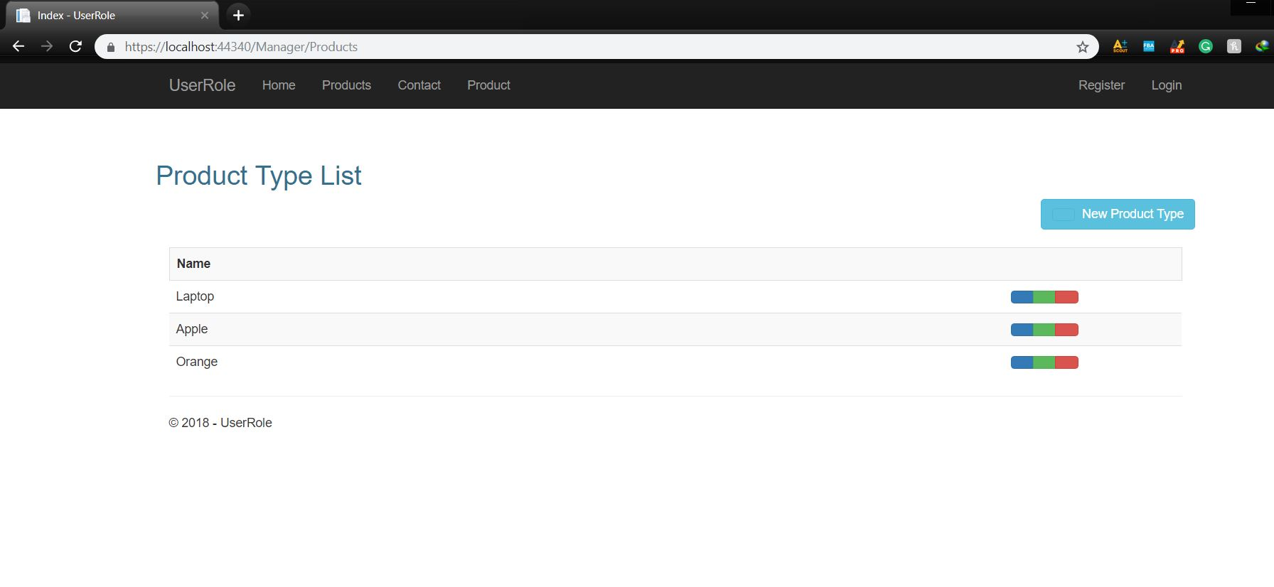
Click the Products you see the add some Products

Slide 32
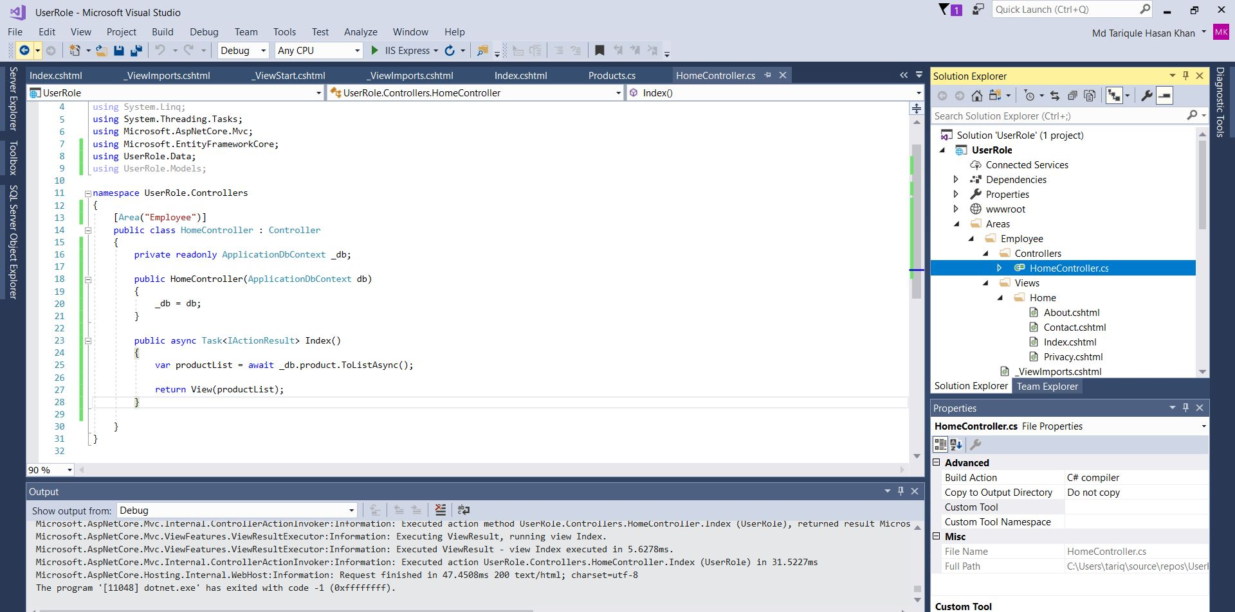
Click on the HomeController in Employees
Add the Codes Below
Notes:
using System;
using System.Collections.Generic;
using System.Diagnostics;
using System.Linq;
using System.Threading.Tasks;
using Microsoft.AspNetCore.Mvc;
using Microsoft.EntityFrameworkCore;
using UserRole.Data;
using UserRole.Models;
namespace UserRole.Controllers
{
[Area("Employee")]
public class HomeController : Controller
{
private readonly ApplicationDbContext _db;
public HomeController(ApplicationDbContext db)
{
_db = db;
}
public async Task<IActionResult> Index()
{
var productList = await _db.product.ToListAsync();
return View(productList);
}
}
}

Slide 33
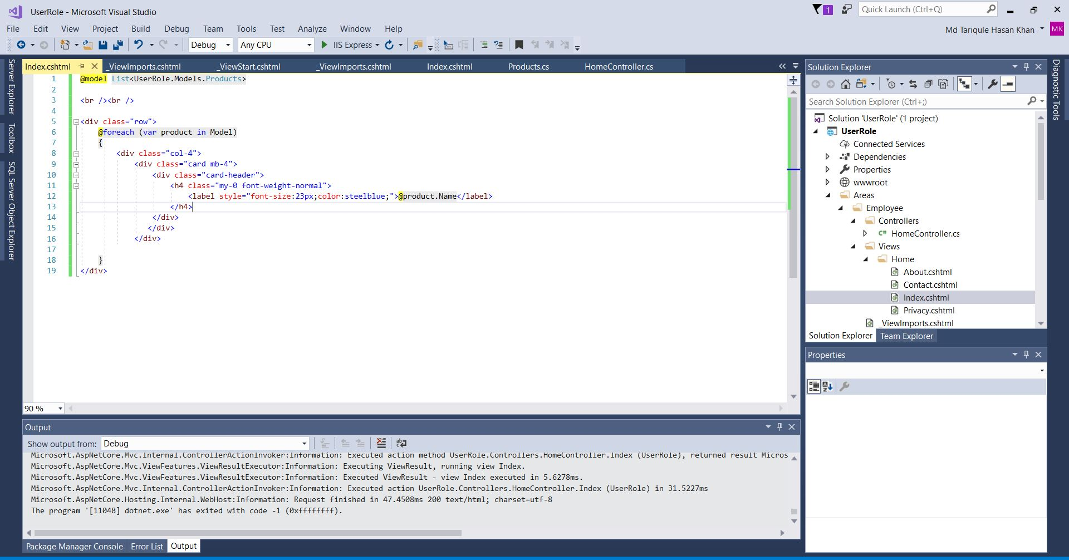
Click On the Index and remove everything and add the following
Notes:
@model List<UserRole.Models.Products>
<br /><br />
<div class="row">
@foreach (var product in Model)
{
<div class="col-4">
<div class="card mb-4">
<div class="card-header">
<h4 class="my-0 font-weight-normal">
<label style="font-size:23px;color:steelblue;">@product.Name</label>
</h4>
</div>
</div>
</div>
}
</div>

Slide 34
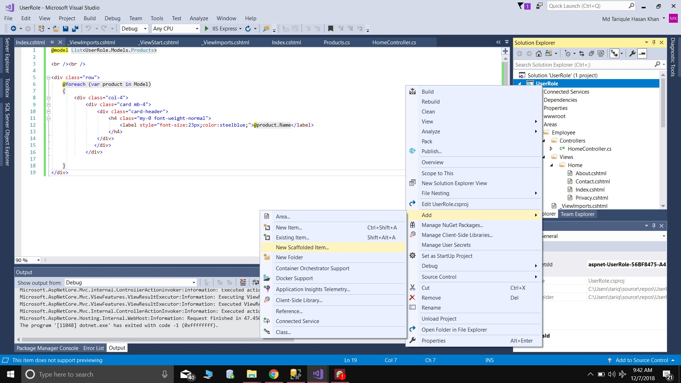
Now Follow this carefully
By default VS hides the Identity Pages so we bring it by clicking on thw scaffolding items.

Slide 35
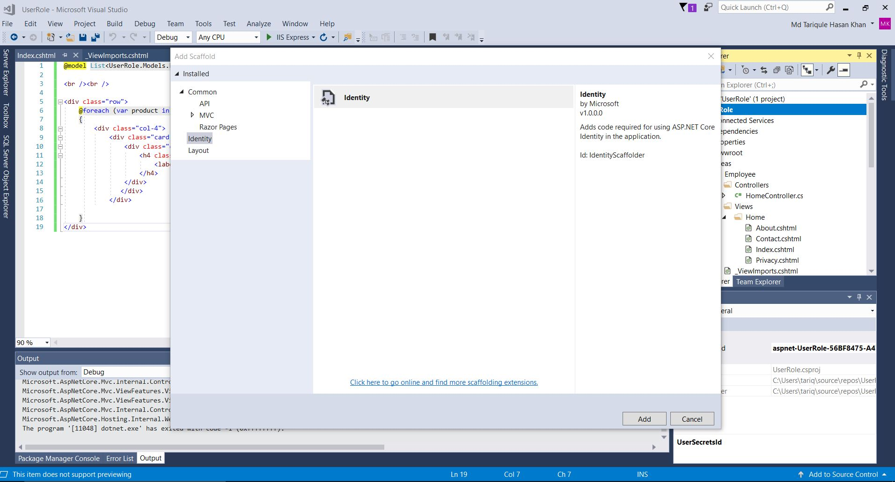
Click On the Identity And Hit ADD

Slide 36
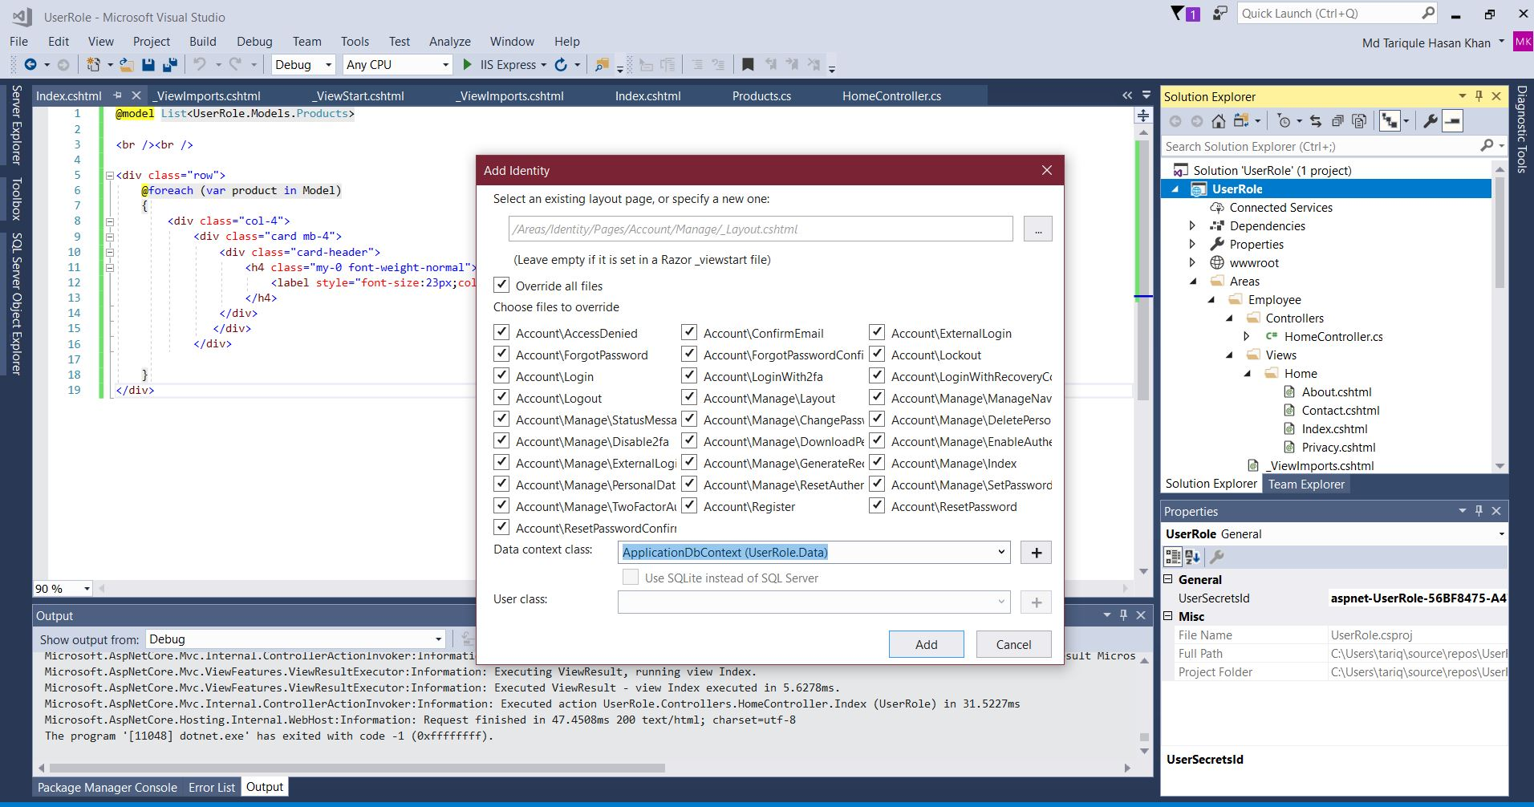
Select All

Slide 37
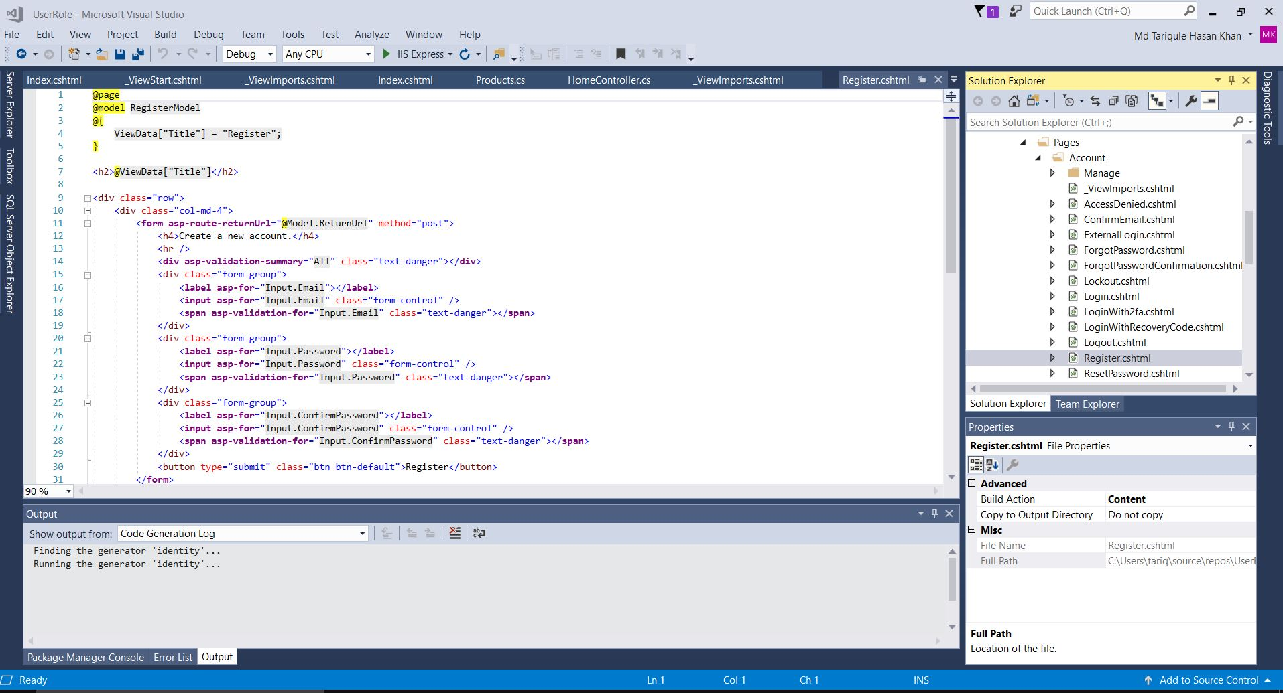
Click On the Register.cshtml

Slide 38
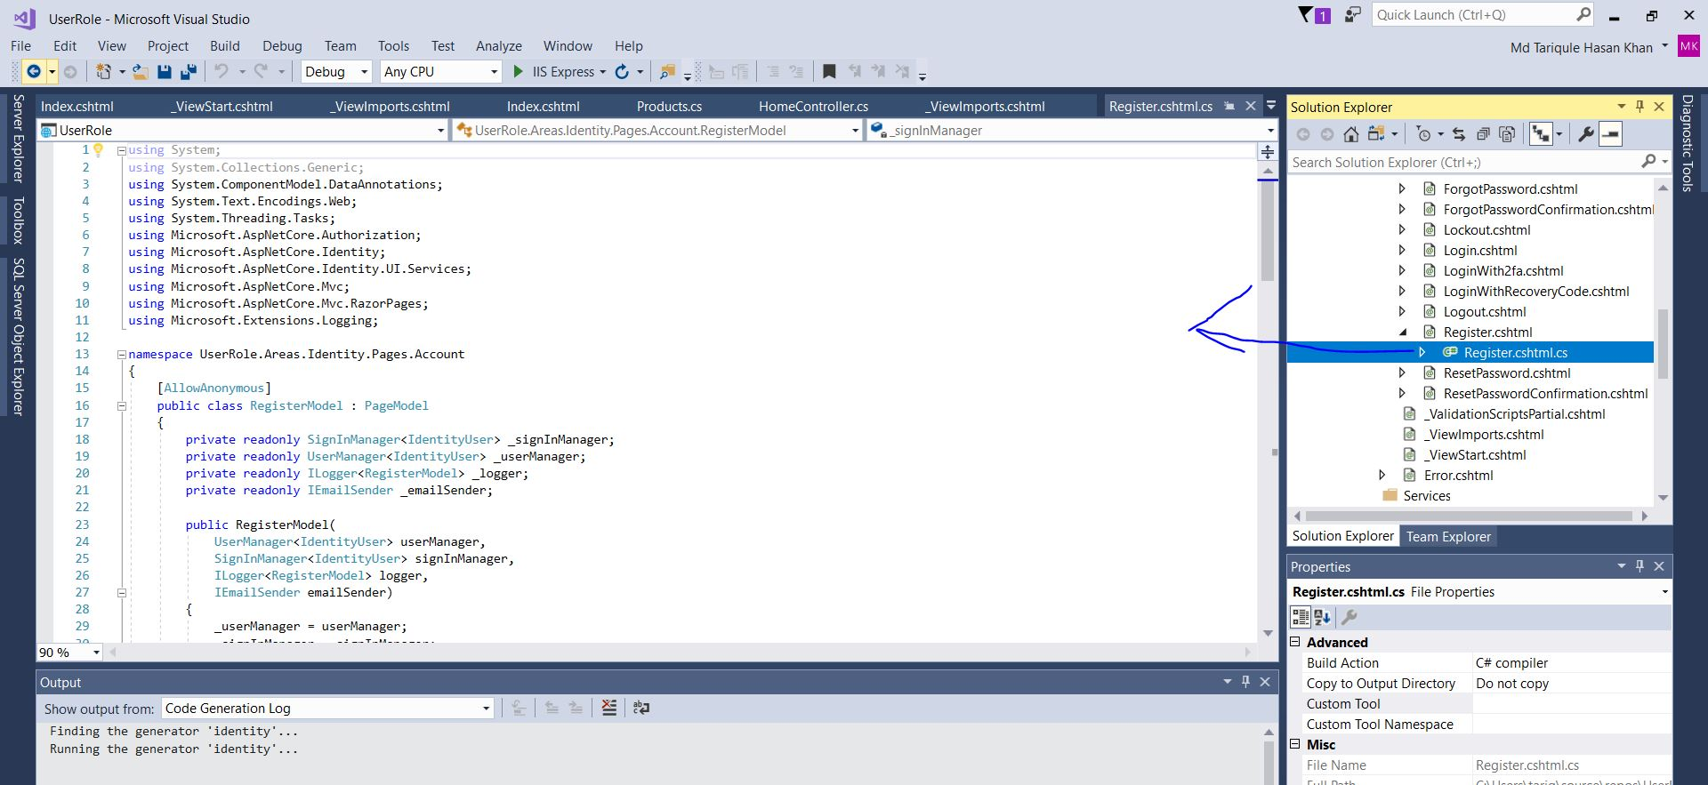
Now click On the Register.cshml.cs

Slide 39
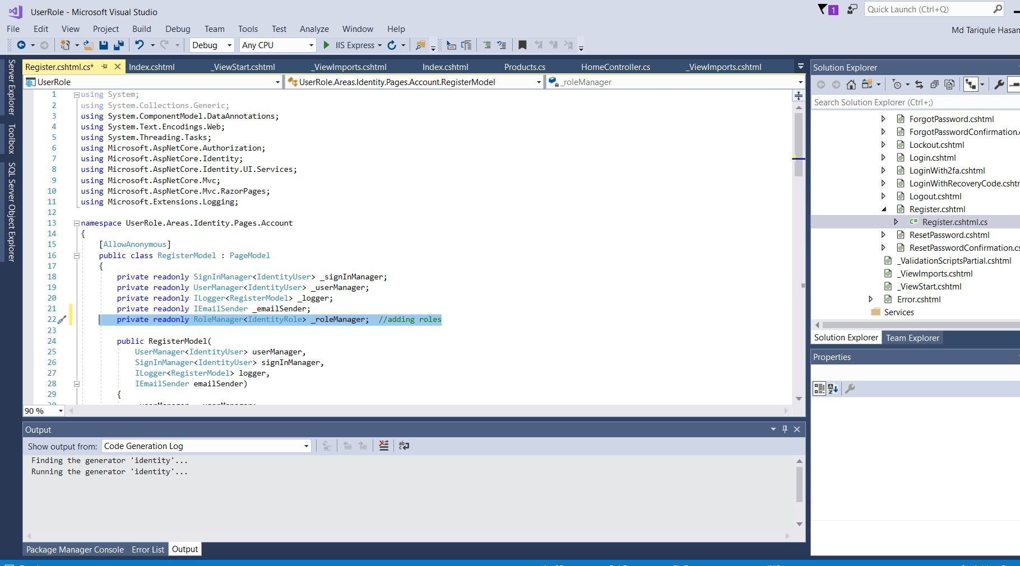
Now lets add Role
Asp.net has something default called RoleManager can use it to make our Roles

Slide 40
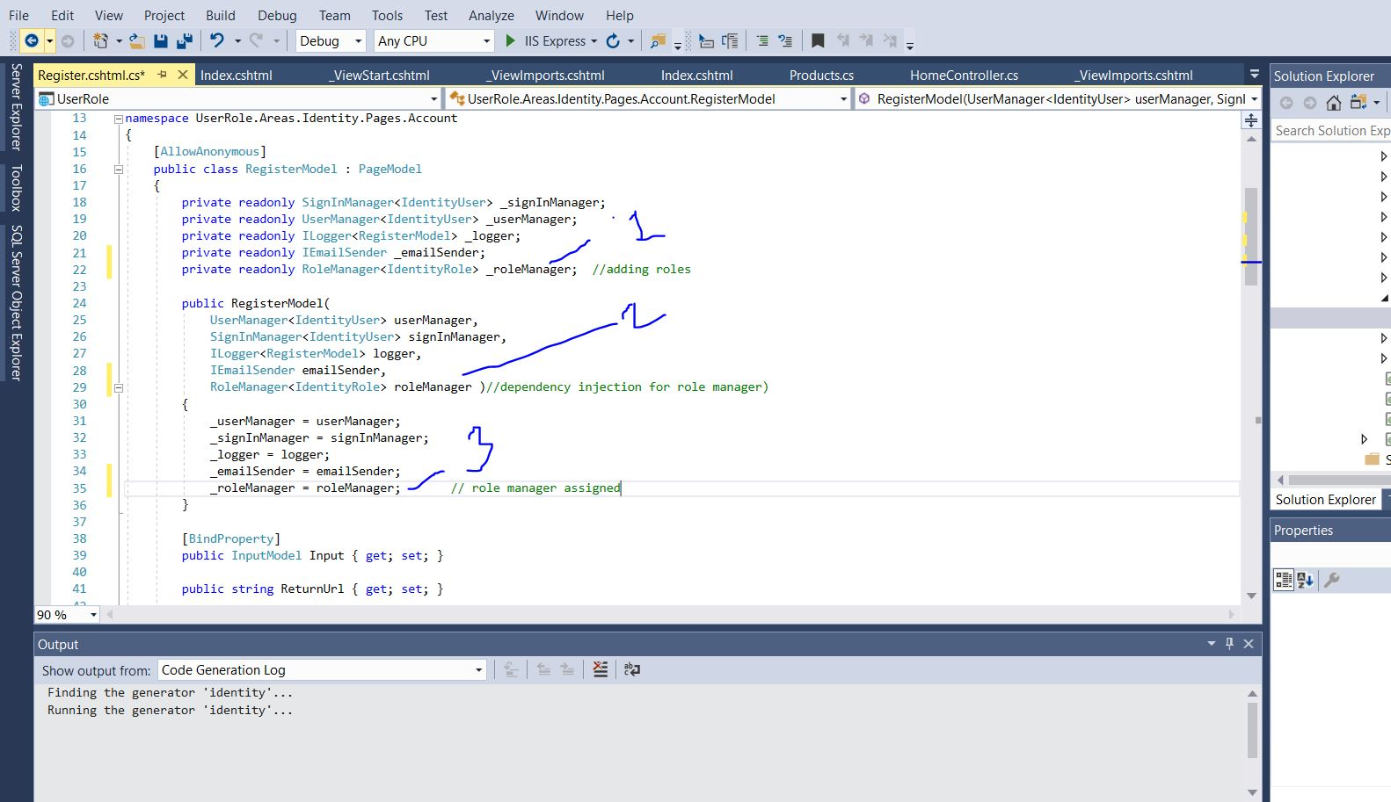
Link it with our DB in 3steps

Slide 41
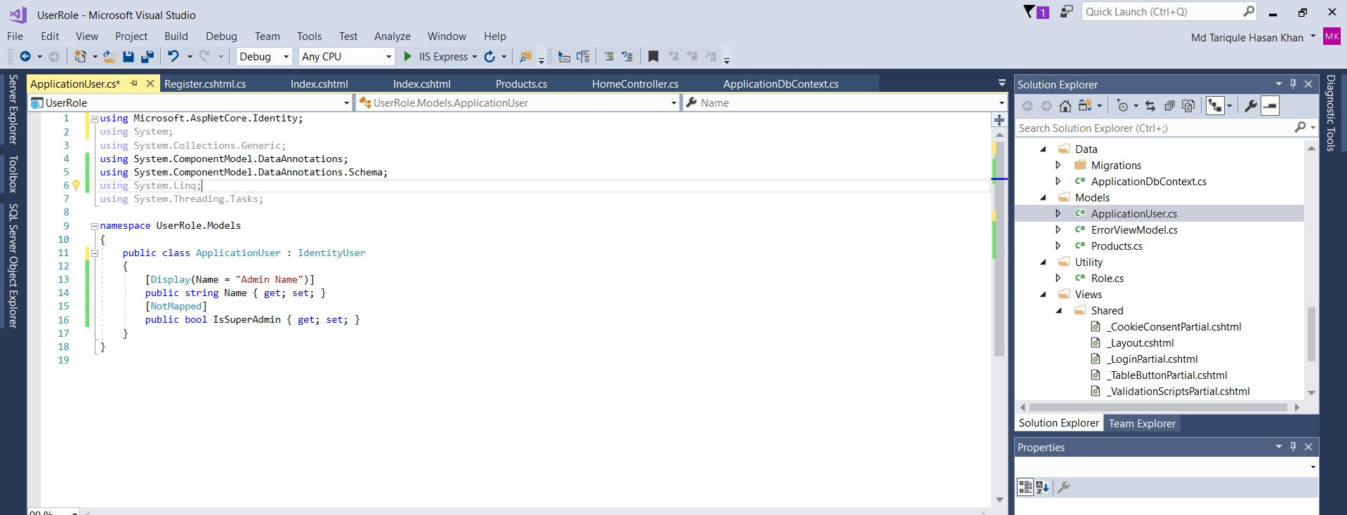
Now lets add a Model class called ApplicationUser
Notes:
using Microsoft.AspNetCore.Identity;
using System;
using System.Collections.Generic;
using System.ComponentModel.DataAnnotations;
using System.ComponentModel.DataAnnotations.Schema;
using System.Linq;
using System.Threading.Tasks;
namespace UserRole.Models
{
public class ApplicationUser : IdentityUser
{
[Display(Name = "Admin Name")]
public string Name { get; set; }
[NotMapped]
public bool IsSuperAdmin { get; set; }
}
}

Slide 42
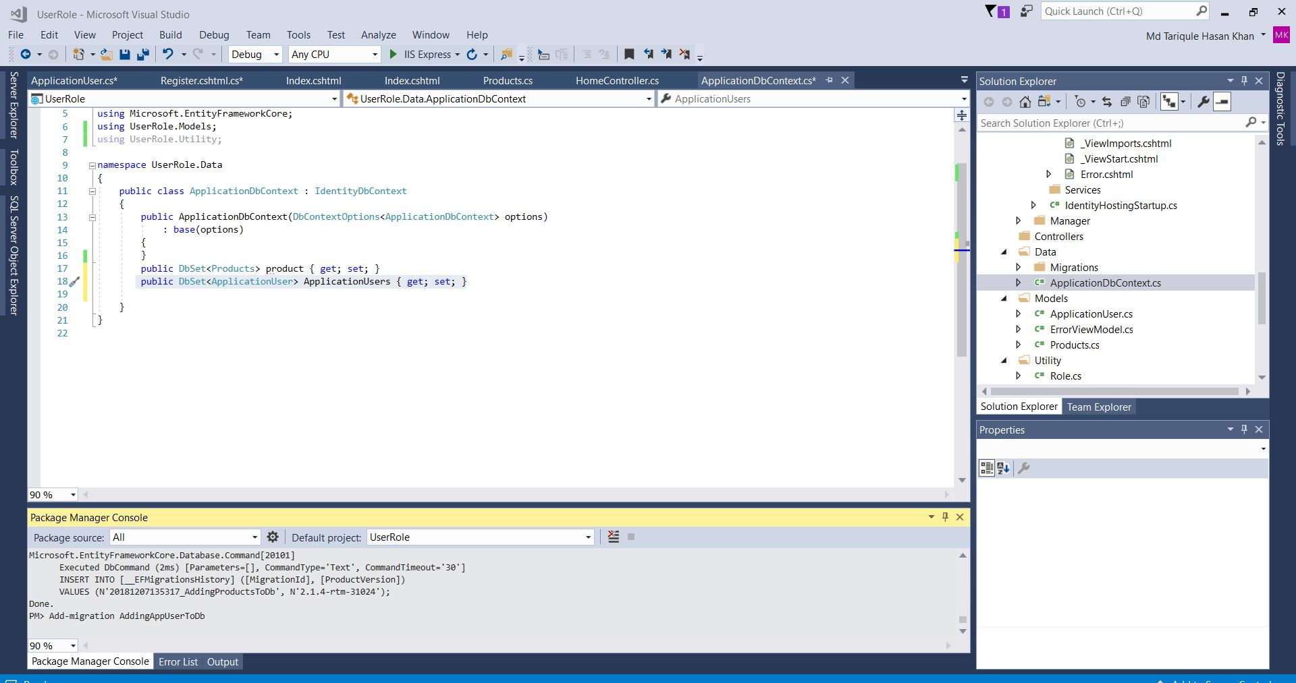
Add it to the ApplicationDbCntext
Then do the Migrations and update database

Slide 43
Migrations and update dstabase

Slide 44
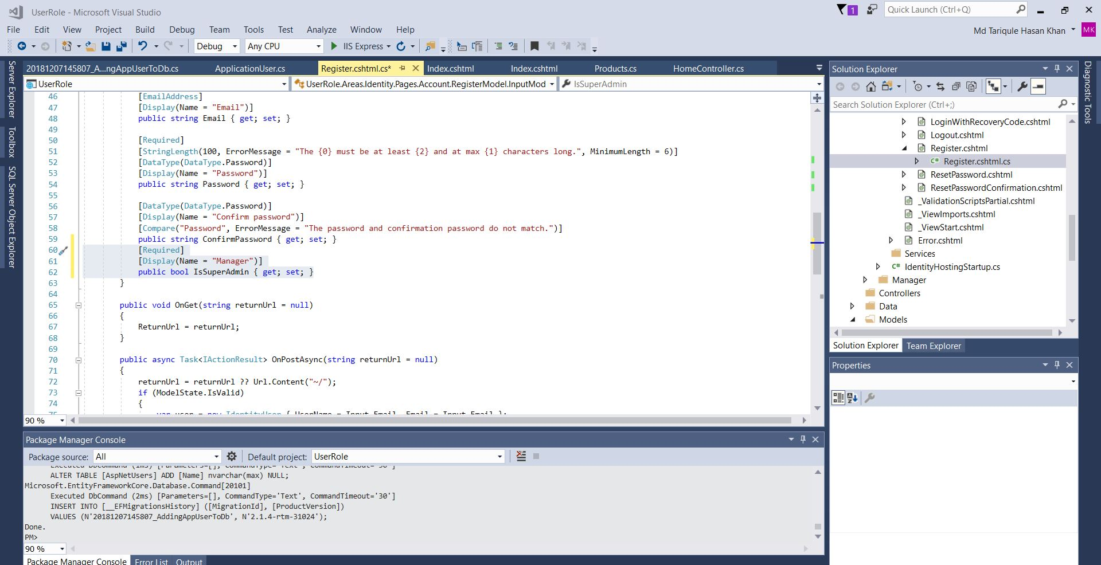
Now Lets Add this in the Register.cshtml.cs

Slide 45
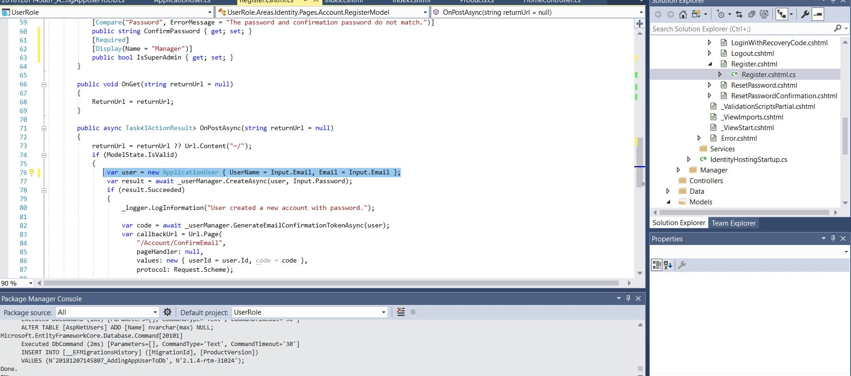
Change the Identity To ApplicationUser

Slide 46
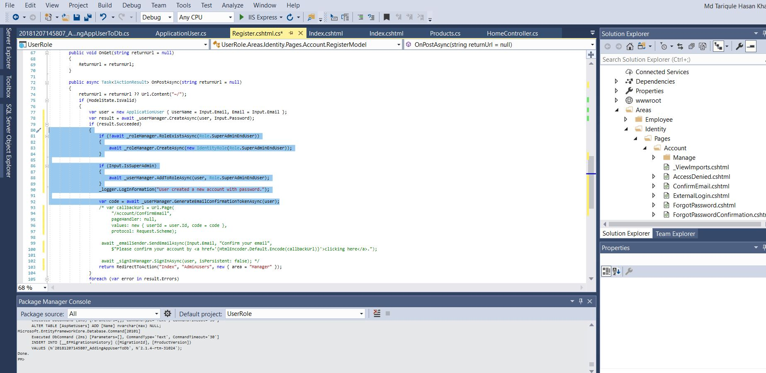
Add this in the Register.cshtml.cs

Slide 47
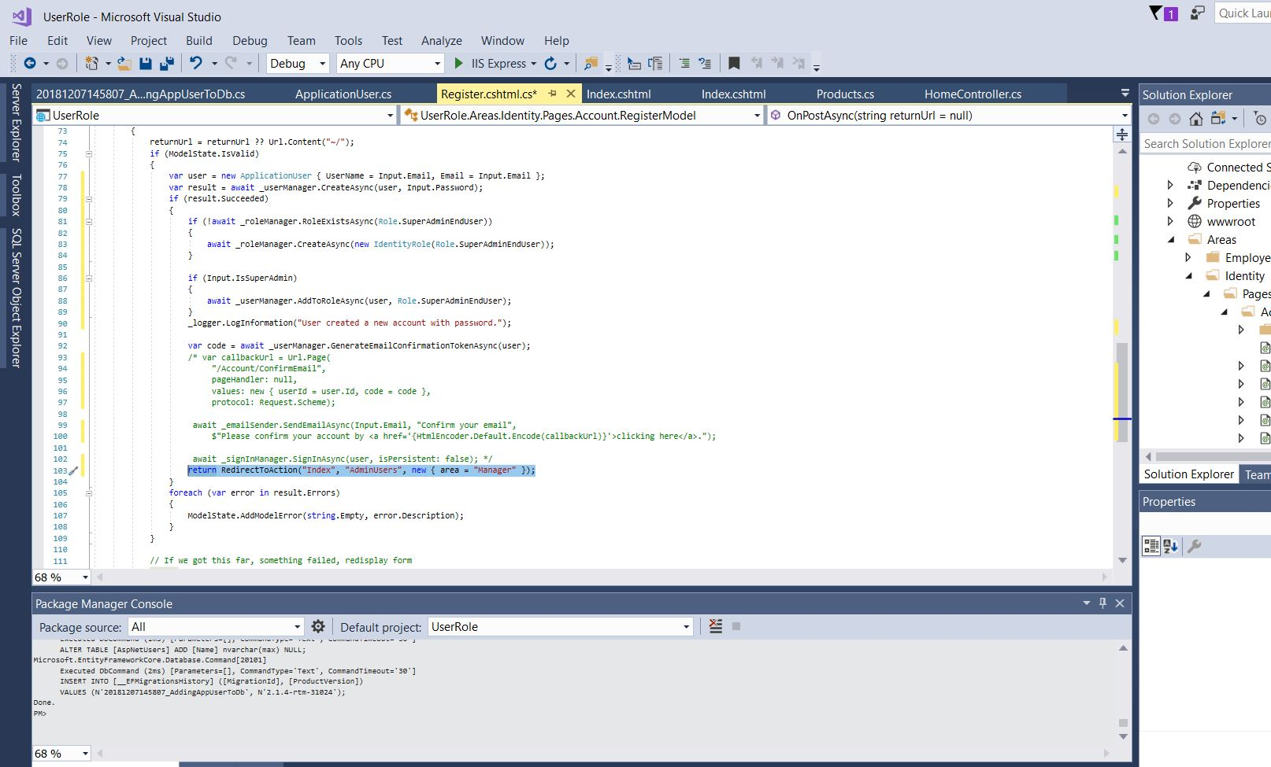
Also add this
Notes:
using System;
using System.Collections.Generic;
using System.ComponentModel.DataAnnotations;
using System.Text.Encodings.Web;
using System.Threading.Tasks;
using Microsoft.AspNetCore.Authorization;
using Microsoft.AspNetCore.Identity;
using Microsoft.AspNetCore.Identity.UI.Services;
using Microsoft.AspNetCore.Mvc;
using Microsoft.AspNetCore.Mvc.RazorPages;
using Microsoft.Extensions.Logging;
using UserRole.Models;
using UserRole.Utility;
namespace UserRole.Areas.Identity.Pages.Account
{
[AllowAnonymous]
public class RegisterModel : PageModel
{
private readonly SignInManager<IdentityUser> _signInManager;
private readonly UserManager<IdentityUser> _userManager;
private readonly ILogger<RegisterModel> _logger;
private readonly IEmailSender _emailSender;
private readonly RoleManager<IdentityRole> _roleManager; //adding roles
public RegisterModel(
UserManager<IdentityUser> userManager,
SignInManager<IdentityUser> signInManager,
ILogger<RegisterModel> logger,
IEmailSender emailSender,
RoleManager<IdentityRole> roleManager )//dependency injection for role manager)
{
_userManager = userManager;
_signInManager = signInManager;
_logger = logger;
_emailSender = emailSender;
_roleManager = roleManager; // role manager assigned
}
[BindProperty]
public InputModel Input { get; set; }
public string ReturnUrl { get; set; }
public class InputModel
{
[Required]
[EmailAddress]
[Display(Name = "Email")]
public string Email { get; set; }
[Required]
[StringLength(100, ErrorMessage = "The {0} must be at least {2} and at max {1} characters long.", MinimumLength = 6)]
[DataType(DataType.Password)]
[Display(Name = "Password")]
public string Password { get; set; }
[DataType(DataType.Password)]
[Display(Name = "Confirm password")]
[Compare("Password", ErrorMessage = "The password and confirmation password do not match.")]
public string ConfirmPassword { get; set; }
[Required]
[Display(Name = "Manager")]
public bool IsSuperAdmin { get; set; }
}
public void OnGet(string returnUrl = null)
{
ReturnUrl = returnUrl;
}
public async Task<IActionResult> OnPostAsync(string returnUrl = null)
{
returnUrl = returnUrl ?? Url.Content("~/");
if (ModelState.IsValid)
{
var user = new ApplicationUser { UserName = Input.Email, Email = Input.Email };
var result = await _userManager.CreateAsync(user, Input.Password);
if (result.Succeeded)
{
if (!await _roleManager.RoleExistsAsync(Role.SuperAdminEndUser))
{
await _roleManager.CreateAsync(new IdentityRole(Role.SuperAdminEndUser));
}
if (Input.IsSuperAdmin)
{
await _userManager.AddToRoleAsync(user, Role.SuperAdminEndUser);
}
_logger.LogInformation("User created a new account with password.");
var code = await _userManager.GenerateEmailConfirmationTokenAsync(user);
/* var callbackUrl = Url.Page(
"/Account/ConfirmEmail",
pageHandler: null,
values: new { userId = user.Id, code = code },
protocol: Request.Scheme);
await _emailSender.SendEmailAsync(Input.Email, "Confirm your email",
$"Please confirm your account by <a href='{HtmlEncoder.Default.Encode(callbackUrl)}'>clicking here</a>.");
await _signInManager.SignInAsync(user, isPersistent: false); */
return RedirectToAction("Index", "Products", new { area = "Manager" });
}
foreach (var error in result.Errors)
{
ModelState.AddModelError(string.Empty, error.Description);
}
}
// If we got this far, something failed, redisplay form
return Page();
}
}
}

Slide 48
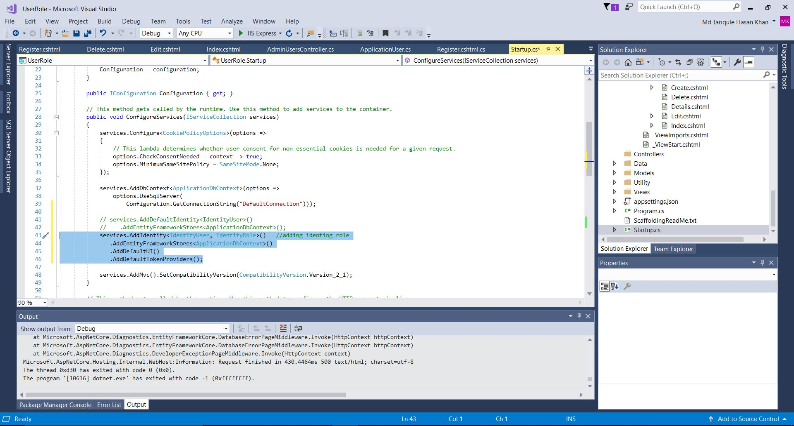
In Startup class we need to add this

Slide 49
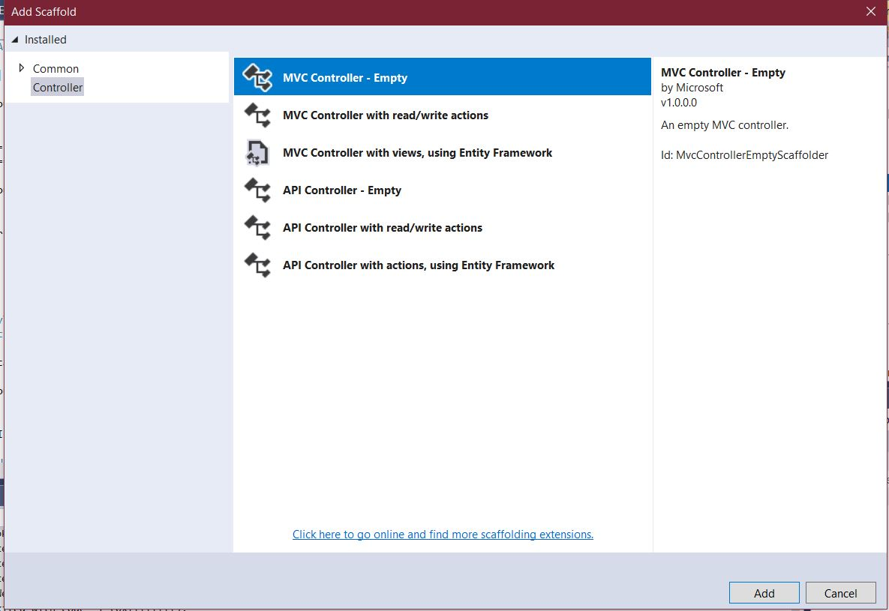
Lets create controller for the ApplicationUser Model

Slide 50
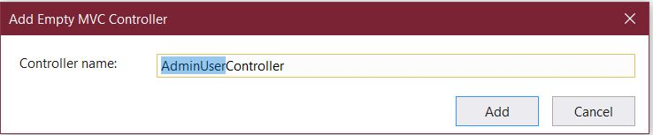
Name is AdminUser

Slide 51
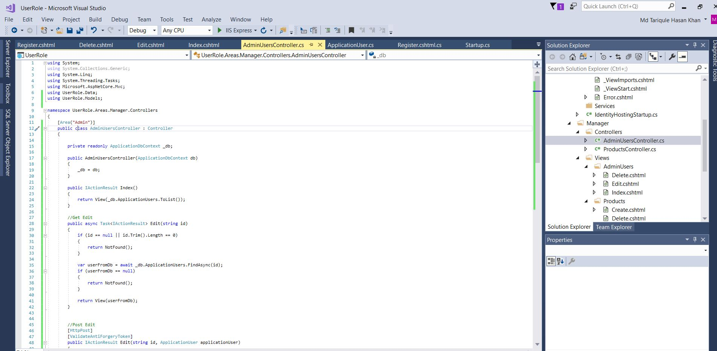
Write the Code in AdminUser
We made this controller and later on view for this will give us the benefits of seeing all the admins in the page. I will show in the later slides
Notes:
using System;
using System.Collections.Generic;
using System.Linq;
using System.Threading.Tasks;
using Microsoft.AspNetCore.Authorization;
using Microsoft.AspNetCore.Mvc;
using UserRole.Data;
using UserRole.Models;
using UserRole.Utility;
namespace UserRole.Areas.Manager.Controllers
{
[Authorize(Roles = Role.SuperAdminEndUser)] // giving access only SuperAdminEndUser AKA "Manager"
[Area("Manager")]
public class AdminUsersController : Controller
{
private readonly ApplicationDbContext _db;
public AdminUsersController(ApplicationDbContext db)
{
_db = db;
}
public IActionResult Index()
{
return View(_db.ApplicationUsers.ToList());
}
//Get Edit
public async Task<IActionResult> Edit(string id)
{
if (id == null || id.Trim().Length == 0)
{
return NotFound();
}
var userFromDb = await _db.ApplicationUsers.FindAsync(id);
if (userFromDb == null)
{
return NotFound();
}
return View(userFromDb);
}
//Post Edit
[HttpPost]
[ValidateAntiForgeryToken]
public IActionResult Edit(string id, ApplicationUser applicationUser)
{
if (id != applicationUser.Id)
{
return NotFound();
}
if (ModelState.IsValid)
{
ApplicationUser userFromDb = _db.ApplicationUsers.Where(u => u.Id == id).FirstOrDefault();
userFromDb.Name = applicationUser.Name;
userFromDb.PhoneNumber = applicationUser.PhoneNumber;
_db.SaveChanges();
return RedirectToAction(nameof(Index));
}
return View(applicationUser);
}
//Get Delete
public async Task<IActionResult> Delete(string id)
{
if (id == null || id.Trim().Length == 0)
{
return NotFound();
}
var userFromDb = await _db.ApplicationUsers.FindAsync(id);
if (userFromDb == null)
{
return NotFound();
}
return View(userFromDb);
}
//Post Delete
[HttpPost, ActionName("Delete")]
[ValidateAntiForgeryToken]
public IActionResult DeletePOST(string id)
{
ApplicationUser userFromDb = _db.ApplicationUsers.Where(u => u.Id == id).FirstOrDefault();
userFromDb.LockoutEnd = DateTime.Now.AddYears(1000);
_db.SaveChanges();
return RedirectToAction(nameof(Index));
}
}
}

Slide 52
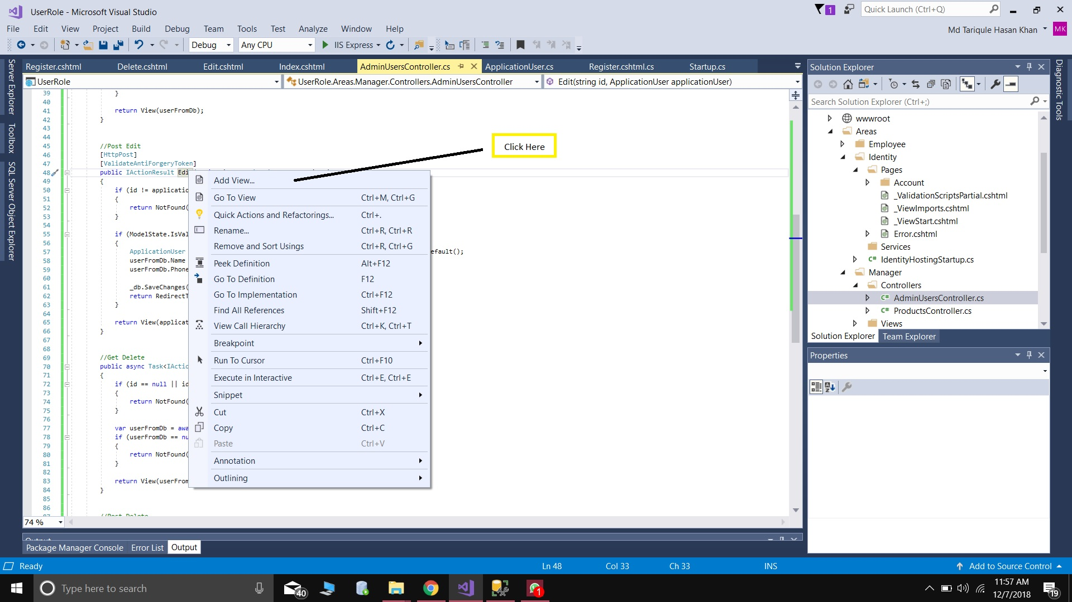
Make the CRUD for the AminUser Controller

Slide 53
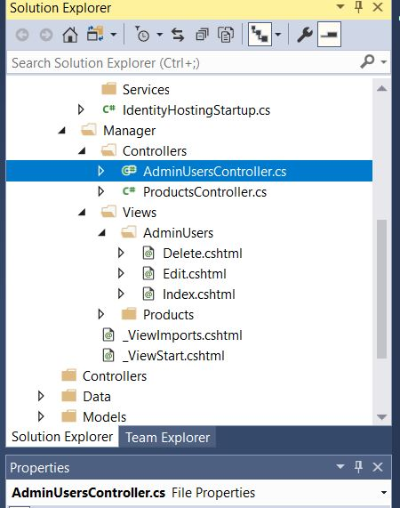
Will Look This

Slide 54
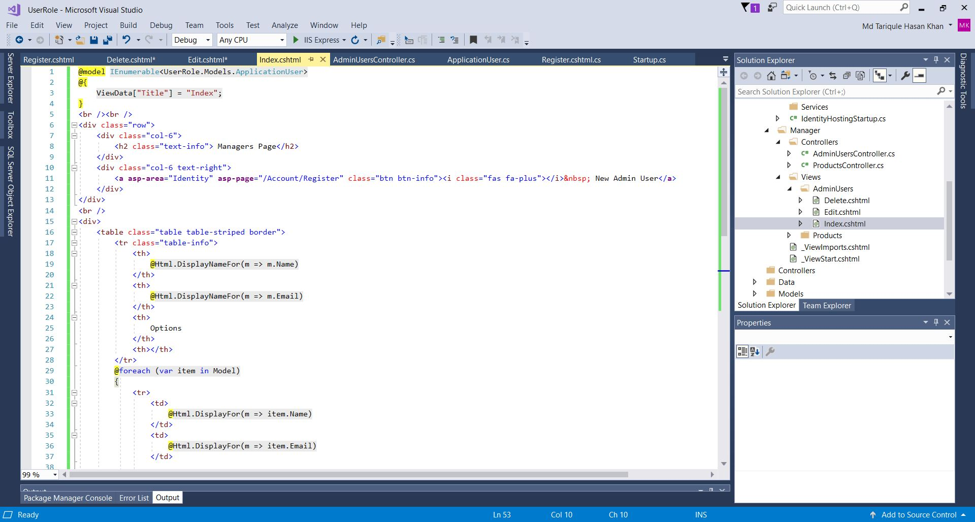
Add some code in the Index view of the AdminUser

Slide 55

This is the code for the Edit in AdminUSer

Slide 56

Write the this code to give admin access

Slide 57

In Layout make another tab for the Amin

Slide 58

We need to include this

Slide 59

NOW LETS RUN IT!
Now we are not logged it. So we have the user interface where we will not be able to add products.

Slide 60

Lets Register as a Manager

Slide 61

Fill everything
Check this option

Slide 62

As manger we can add products and remove and also view admin and remove or add admin

Slide 63

Lets restricts the Employees to add admin. So we we add this on the ProductsController

Slide 64

We will have to change in our _Layout to restrict the employee access

Slide 65

Now lets run the code and register without checking the manger option. Then we cannot access the Admin page

Slide 66
Now Employees cannot view the admin page but they can only add products and view products. Customers can view products only. Managers can add admin and remove, also add products and remove products

Slide 67
Thanks

